Slide 1

Chapter 18 Arbitration

Slide 2

18.1 Dispute Resolution Processes
18.2 Arbitration Agreement
18.3 Execute Arbitral Award
Contents

Slide 3
18.1 Dispute Resolution Processes
1. Negotiation 友好协商
Informal and amicable, no third party involved
2. Conciliation 调解
Neutral third party (conciliator), no binding decision
3. Arbitration 仲裁
Neutral third party (arbitrator), binding decision
4. Litigation 诉讼
Dispute settlement through a court of law, final and legally
binding decision

Slide 4
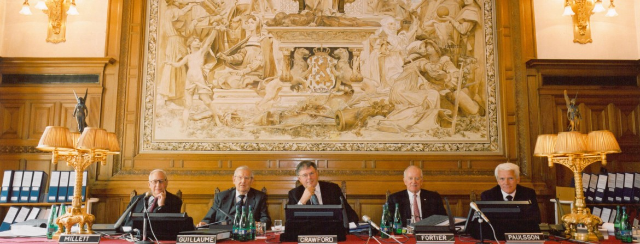
Definition of Arbitration
A technique for the resolution of disputes outside the courts. The parties to a dispute refer it to arbitration by a neutral third party and agree to be bound by the arbitration decision (the "award"). The third party reviews the evidence in the case and imposes a binding decision on both sides.
THE PERMANENT COURT OF ARBITRATION (PCA), HAGUE, NETHERLANDS

Slide 5
Advantages over Litigation
Speed
Arbitration is faster than litigation in court.
Flexibility
Can customize an arbitration procedure to meet both parties’
needs
Choice of arbitrator
Confidentiality
Arbitration proceedings and decisions are non-public
Litigation in a public courtroom - bad publicity
Lower Cost

Slide 6
18.2 Arbitration Agreement
Arbitration agreement is a prerequisite to arbitrate a dispute.
Forms of Arbitration Agreement
  Arbitration clause before a dispute arises
  Submission agreement after a dispute arises
  Those two kinds of arbitration agreements have equal legal effect.
Function of Arbitration Agreement
The agreement eliminates the rights to bring a suit to the
court of law

Slide 7
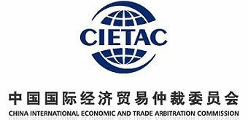


Elements of Arbitration Arrangement
Place of Arbitration
In plaintiff’s (申请人) country
In defendant’s (被申请人) country
In a third country
Arbitration Institution
ad hoc (provisional) arbitration
Institutional arbitration body (permanent)
CIETAC 中国国际经济贸易仲裁委员会, CCPIT 中国国际贸易促
进委员会, LCIA in London 伦敦国际仲裁庭, ICC 国际商会, AAA
美国仲裁协会

Slide 8
Rules of Arbitration
Usually rules of the place of arbitration apply, but rules of other countries may apply if agreed by both parties and the arbitration commission.
Award of Arbitration
Award is final and binding
Usually the party cannot appeal arbitration awards in the
courts
Fees of Arbitration
Usually be borne by the losing party

Slide 9
Sample Arbitration Clause in the Contract
All disputes arising out of the performance of or relating to this Contract shall be settled amicably through friendly negotiation. In case of no settlement can be reached through negotiation the case shall then be submitted to the China International Economic and Trade Arbitration Commission (中国国际经济贸易仲裁委员会) for arbitration in accordance with its Provisional Rules of Procedure. The arbitral award is final and binding upon both parties. The fees for arbitration shall be borne by the losing party unless otherwise awarded.

Slide 10

Arbitral Proceedings of CIETAC
Application for arbitration, defense and counter-claim
The composition of the arbitration tribunal
Hearing
Arbitral award
The enforcement of arbitral award

Slide 11

18.3 Execute Arbitral Award
Final and binding
May not be challenged in the court of law
Cannot make a request to any other organization for revising the arbitral award
The parties must execute the award immediately or within specified time limit

Slide 12


Enforce an arbitral award before a court of law
The New York Convention: recognition and enforcement of foreign arbitral awards
157 State Parties, as of March 2017
the 1958 New York Convention on the Recognition and Enforcement of Arbitral Awards
1987

Slide 13
Thank You

