Slide 1
Chapter 15
Documentary Credit

Slide 2
15.1 Definition & Types
Contents
15.2 Expedition
15.3 Amendment

Slide 3
15.1 Definition and Types

Slide 4
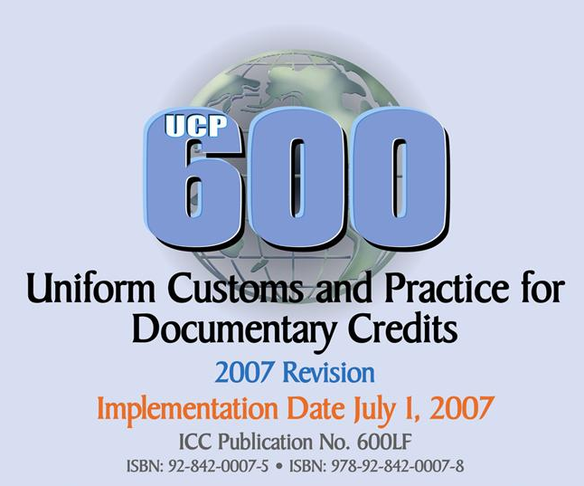
Applicable when the credit expressly indicates that is subject to these “rules”.

Slide 5
Use of SWIFT:
40E: Applicable Rules
UCP LATEST VERSION
Use of telex or letter:
This credit is subject to the Uniform Customs and Practice for Documentary Credits, 2007 Revision, ICC Publication No. 600.
This credit is subject to UCP 600.

Slide 6

Credit
Credit means any arrangement, however named or described, that is irrevocable and thereby constitutes a definite undertaking of the issuing bank to honour a complying presentation.
UCP 600

Slide 7
A
bank's
conditional
Terms are complied with.
（单单一致，单证一致）
written undertaking of payment.

Slide 8
We exported 600 pieces of Women Sweaters to an American company. It was contracted “180 pieces, green; 420 pieces, red ”. The relevant credit stipulated “180 pieces, red; 420 pieces, green”. We dispatched as contracted, but the issuing bank refused to make payment.
Q: Why did the bank refuse to make payment? What is a good choice for us?

Slide 9


Characteristics of L/C
Bank credit
Independence
Only documents

Slide 10

Triangular Contractual Arrangement
Applicant
(Importer)
Sales Contract
Beneficiary
(Exporter)
Application for L/C
L/C
Issuing Bank

Slide 11
Other Parties Involved
Advising Bank 通知行
Negotiating Bank 议付行
Confirming Bank 保兑行
Paying Bank 付款行
Reimbursing Bank 偿付行

Slide 12
Paying Bank VS. Reimbursing Bank
Every credit has its Paying Bank,
but not every credit has its Reimbursing Bank.
Paying Bank | Reimbursing Bank
Drawee Bank usu. the Issuing Bank itself | Clearing Bank
should check the documents against credit | has no responsibility to check the documents against credit

Slide 13
Importer
Exporter
S/C
Applicant
Beneficiary
Shipping Line
Issuing Bank
Advising Bank

Slide 14
If the credit is negotiable
S/C
Applicant
Beneficiary
Shipping Line
Issuing Bank
Advising Bank /Negotiating Bank

Slide 15
Basic Types of L/C
Irrevocable or Revocable
A credit is irrevocable even if there is no indication to that effect.
Article 3, UCP 600

Slide 16
Basic Types of L/C
Clean or Documentary
Irrevocable Documentary Credit

Slide 17
41A AVAILABLE WITH ... (a bank) BY...
  BY PAYMENT（即期付款）
  BY ACCEPTANCE（远期承兑）
  BY DEF PAYMENT（迟期付款）

Slide 18
41A AVAILABLE WITH ... (a bank) BY...
  BY NEGOTIATION（议付）
41D AVAILABLE WITH ANY BANK IN ...
  自由议付信用证

Slide 19

Confirmed Credit 保兑信用证
Who takes primary liability of payment?
&
Issuing Bank
Confirming Bank

Slide 20
We received an irrevocable L/C, confirmed by a foreign-invested bank in China. We prepared all the required documents after shipment, but the foreign-invested bank notified us that the Issuing Bank went bankruptcy and they took no responsibility of negotiation or payment. What they could do was only to collect from the importer on behalf of us.
Q: How to deal with this situation?

Slide 21
Transferable Credit 可转让信用证
a credit that specifically states it is “transferable”
Article 38b, UCP 600
First Beneficiary
In whole or in part
Second Beneficiaries
Subsequent Beneficiary

Slide 22
Why to use a transferable credit?
Export Broker

Slide 23
What if an L/C cannot be transferred?
Back-to-back credits

Slide 24
First Beneficiary
Secondary
Beneficiary
Applicant
Issuing Bank
Credit 1
Advising Bank
Credit 2

Slide 25
Reciprocal Credits 对开信用证
Applicant
Beneficiary
Credit 1
Credit 2
Exporter
Importer
Beneficiary
Applicant

Slide 26
When to use reciprocal credits?
For barter, counter trade, processing trade, etc.

Slide 27
How to use a reciprocal credit?
Time Credit: for importing parts or raw materials
Sight L/C: for exporting manufactured commodities

Slide 28
15.2 Expedition of L/C

Slide 29
Sales Contract No. W9C08 Goods are ready, please rush to open the relevant L/C.
When to ask for expedition?

Slide 30
We concluded an S/C with a foreign company, H, on CFR basis. The contract only stipulated shipment during October without deadline for the arrival of L/C. Time of shipment was approaching, but the relevant L/C had not arrived yet. Thus, we asked for expedition several times. On October 5, on receiving the notice of L/C establishment, we effected shipment so as to avoid any delay. On October 28, the L/C arrived with stipulations inconsistent with those of S/C. The issuing bank refused to pay for discrepancies in our documents.
Q: Please make your comment.

Slide 31
15.3 Amendment of L/C

Slide 32
Step 1
To proofread
Step 2
To ask for amendment

Slide 33
About the issuing bank (political background, creditability and responsibility)
About the identity of L/C
@ L/C and rules like UCP, ISBP, etc.
Advising Bank
the terms in L/C are consistent with those in contract
there is no special restrictions on the effectiveness of L/C
@ S/C, L/C and UCP
Exporter

Slide 34
Validity
Joker Clause
Type
Required Documents
Involved Parties
Exporter
Shipment
Amount
Draft

Slide 35

Validity
Usually an L/C becomes effective when it reaches the Beneficiary.
  This credit is non-operative unless the opening bank gives further advice.
  This credit is operative only after the buyer obtains the import license.

Slide 36
Validity
Date of expiry
  Requisite content
  Several days after shipment (usu. 7 - 15 days)
Place of expiry
  In the beneficiary's country
  “in China”

Slide 37
Type
If an L/C doesn’t indicate whether it can be revoked or not, what should you do?
  This credit is subject to cancellation or amendment at any time without prior notice to the beneficiary.

Slide 38
Involved Parties
Names and addresses of the beneficiary and applicant are
to be complete
to be consistent with that in the contract

Slide 39
Amount
To be consistent with that in the Contract
Unit price and total amount should be matched.
If there is more or less clause in the quantity, the same tolerance should be allowed in the total amount.

Slide 40
The words "about" or "approximately" used in connection with the amount of the credit or the quantity or the unit price stated in the credit are to be construed as allowing a tolerance not to exceed 10% more or 10% less than the amount, the quantity or the unit price to which they refer.

Slide 41
A tolerance not to exceed 5% more or 5% less than the quantity of the goods is allowed, provided the credit does not state the quantity in terms of a stipulated number of packing units or individual items and the total amount of the drawings does not exceed the amount of the credit.

Slide 42
We export beans to a Korean company. It is contracted, "1,000M/T at USD200 per M/T FOB Dalian with 10% more or less at Seller's option." The relevant L/C duly arrived at our end, which stipulated that the total amount is USD200,000 and the quantity is 1,000M/T." We didn't ask for amendment and shipped 1,050 M/Ts on board.
Q: Could we get payment by L/C?

Slide 43
Draft
Sight Credit
sight draft（if required）
Acceptance Credit
time draft

Slide 44
Shipment
Time of shipment
  There should be a reasonable period between the times of shipment and expiry.
  In case of late arrival of relevant L/C, the beneficiary need to ask for extension of both the time of shipment and the date of expiry.
Partial shipment and Transhipment
Restrictions to the vessels, carrier, ports, etc.

Slide 45
Required Documents
Frequently required documents
  Commercial invoice and Packing List
  Bill of Lading
  Insurance Policy or Certificate
  Draft
  Certificate of Origin
  Inspection of Certificate

Slide 46
Required Documents
Required B/L
clean, on board, made out to order, blank endorsed
  FOB: “freight collect”
  CFR & CIF: “freight prepaid”

Slide 47
Required Documents
Required Insurance Policy
  FOB & CFR: no Insurance Policy or Certificate
  CIF: Insurance Policy or Certificate

Slide 48
Joker Clauses
Those stipulations that disable the beneficiary to present required documents without the help of the applicant.

Slide 49
47-A Additional Conditions: “Once the applicant accepts the documents required by this credit, our bank will make immediate payment.”
When the beneficiary, M, presented documents after shipment, the paying bank refused to make payment with an excuse that the applicant refused to accept for discrepancies.
Q: Did the paying bank have the right to refuse payment?

Slide 50
Applicant
Beneficiary
Applicant
Beneficiary
Issuing Bank
Advising Bank

Slide 51


Amendment must be agreed to by the issuing bank, confirming bank, if any, and the beneficiary
Partial acceptance = Notice of rejection

Slide 52
Thank You

