Slide 1
Chapter 13
Payment Instruments

Slide 2
13.1 Lead-in
13.2 Definition of Bill of Exhcnage
Contents
13.3 Required Contents
13.4 Types
13.5 How to use and finance with drafts

Slide 3
13.1 Lead-in

Slide 4

Cash
Check
Promissory Note
Bill of Exchange

Slide 5
Negotiable instruments should be:
transferable 可转让
non-causative 无因性
requisite in form 要式性

Slide 6
Check 支票
A document that orders a bank to pay a specific amount of money from the payer's (drawer's) account to the payee in whose name the check has been drawn.

Slide 7
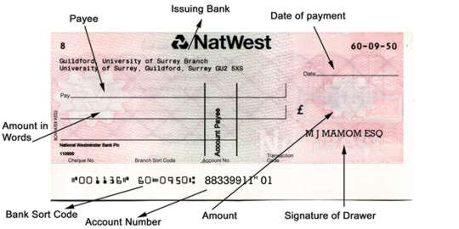

Slide 8
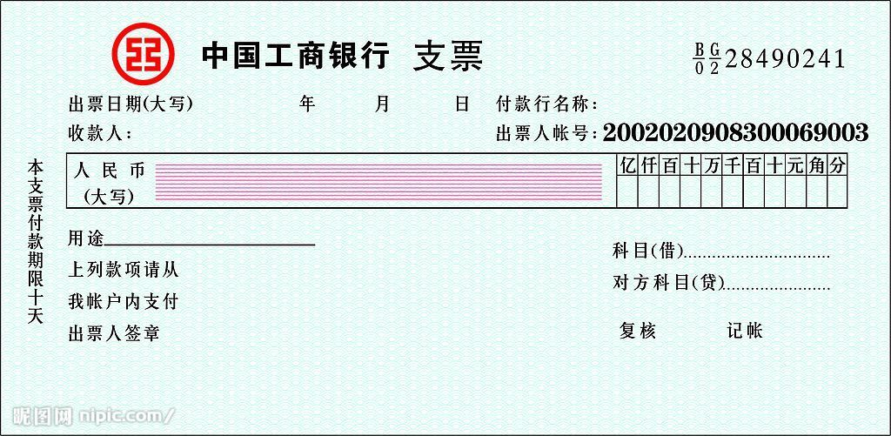

Slide 9
Promissory Note 本票
A writen document on which one party (the drawer) promises to pay a determinate sum of money to the other (the payee), either at a fixed or determinable future time or on demand of the payee.

Slide 10
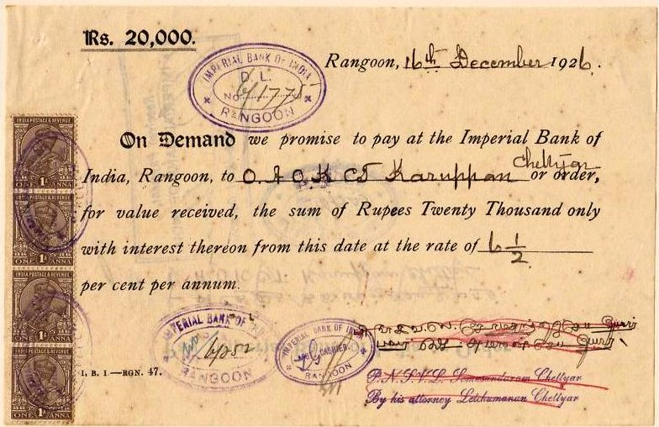

Slide 11
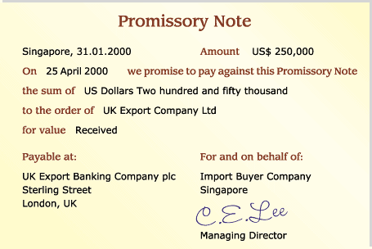
Place & Date
Payee
Drawer
Payer

Slide 12
Bill of Exchange 汇票
the most frequently used instrument
in international trade

Slide 13
13.2 Definition of Bill of Exchange

Slide 14
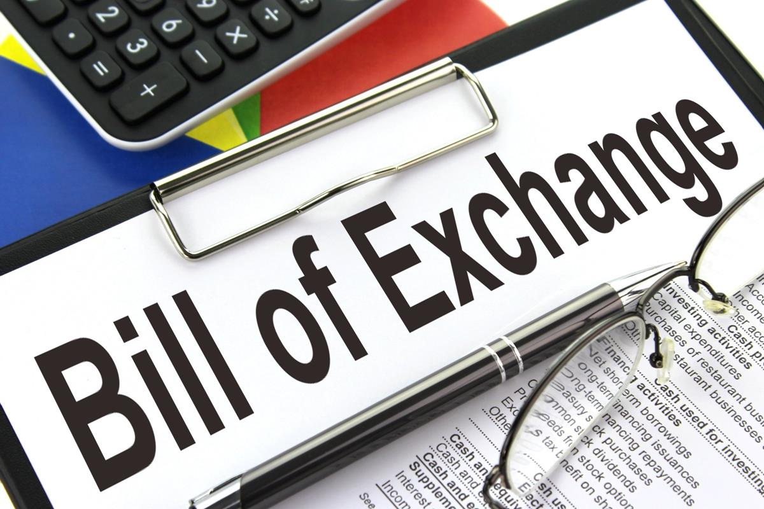


Slide 15
An unconditional order in writing, addressed by one person to another, signed by the person giving it, requiring the person to whom it is addressed to pay on demand or at a fixed or determinable future time a sum certain in money to or to the order of a specified person, or to bearer.
Bills of Exchange Act (1882)

Slide 16
An unconditional order in writing,
addressed by one person to another,
一方向另一方签发的、书面的、无条件的支付命令

Slide 17
由出票人签字
signed by the person giving it,
Drawer
Drawee/
Payer
requiring the person to whom it is addressed
要求受票人

Slide 18
to pay on demand or at a fixed or determinable future time
见票时或在指定的未来时间或可确定的未来某个时间支付
a sum certain in money
一定的金额

Slide 19
to or to the order of a specified person, or to bearer.
Payee
to a specified person
向特定人付款
to the order of a specified person
凭指定人指示付款
to bearer
向持票人付款

Slide 20
13.3 Required Contents

Slide 21
Required Contents
1. 表明“汇票”字样
2. 无条件支付的委托 3. 确定的金额
4. 付款人名称 5. 收款人名称
6. 出票日期 7. 出票人签章
《中华人民共和国票据法》

Slide 22
BILL OF EXCHANGE
Drawn Under Bank of China, London
Irrevocable L/C No. 2003056 Dated January 10, 2015
Payble with interest *** % Per annum
No. 20042 EXCHANGE for HKD 236,000.00 Tianjin, China February 20, 2015
at *** Sight of this FIRST of Exchange (Second of Exchange being unpaid)
Pay to the order of Bank of China, Tianjin Branch the sum of HONGKONG DOLLARS TWO HUNDRED AND THIRTY-SIX THOUSAND ONLY
To: BANK OF CHINA, HONGKONG
China Machinery & Equipment Import & Export Corp., Shanghai Branch
(SIGNATURE)

Slide 23
Drawn Under Bank of China, London
Irrevocable L/C No. 2003056 Dated January 10, 2015
出票条款
Payble with interest *** % Per annum
利息条款

Slide 24
No. 20042 EXCHANGE for HKD 236,000.00 Tianjin, China February 20, 2015
汇票号码
小写金额
出票地点
出票时间
at *** Sight of this FIRST of Exchange (Second of Exchange being unpaid)
付款时间
付一不付二

Slide 25
Pay to the order of Bank of China, Tianjin Branch
收款人
the sum of HONGKONG DOLLARS TWO HUNDRED AND THIRTY-SIX THOUSAND ONLY
大写金额

Slide 26
To: BANK OF CHINA, HONGKONG
付款人/受票人
China Machinery & Equipment Import & Export Corp., Shanghai Branch
(SIGNATURE)
出票人及签章

Slide 27
13.4 Types

Slide 28
Banker’s Draft
D/D
Drawer
银行汇票
Commercial Draft
CollectionL/C
商业汇票

Slide 29
at *** Sight of ......
Sight Draft (Demand Draft)
On Nov. 30
At 30 days after sight
Time Draft
(Usance Draft)
At 30 days after date of draft
At xx days after date of B/L

Slide 30
Pay to *** only
Definte
Pay to *** not transferable
Pay to the order of ***
To order
Pay to *** or order
Pay to bearer/holder
To bearer

Slide 31
Company
Trade Acceptance Draft
Commercial credit
Acceptor
Bank
Bank Acceptance Draft
Bank credit

Slide 32
Clean Draft
Draft
光票
Documentary Draft
跟单汇票
Shipping Documents
Draft

Slide 33
13.5 How to use and finance with drafts

Slide 34
How to use drafts?

Slide 35

Draw
Present
Pay
Dishonor
Recourse
Accept
Present

Slide 36
How to finance with a draft?

Slide 37

1

Slide 38

Holder
Bank
Discount Value
Discount
Face Value
Payer

Slide 39


2

Slide 40
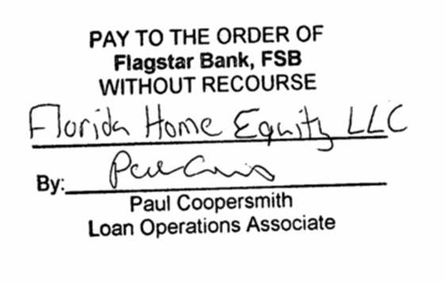
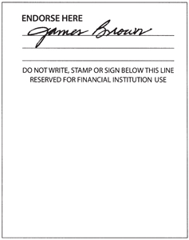
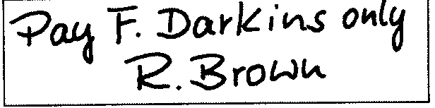
Special
Blank
Restricted

Slide 41
Thank You

