Slide 1

Chapter 12 Insurance Practice
in International Trade

Slide 2

12.1 General Procedures
12.2 Who Arranges Insurance?
12.3 CIC or ICC? Which Coverage?
12.4 Insurance Amount and Premium
12.5 Insurance Documents
12.6 Claims
Contents

Slide 3
12.1 General Procedures
Who Arranges Insurance?
CIC or ICC?
Which Coverage?
Insurance Documents
Insured Amount and Premium
Sales Contract
Insurance Claim

Slide 4
12.2 Who Arranges Insurance?
Under FOB, CFR, FCA and CPT trade terms, the buyer is to arrange insurance and pay premium.
“To be effected by the buyer”
Under CIF and CIP trade terms, the insurance clause can stipulate that:
“Insurance to be covered by the seller for 110% of the total invoice value against all risks and war risks, as per Ocean Marine Cargo Clauses and Ocean Marine Cargo War Risks Clauses of the PICC, dated 1/1/1981.”

Slide 5

12.3 CIC or ICC? Which Coverage?
For Chinese exporters, usually CIC is used. But ICC is also acceptable upon the request of the foreign buyer.
Factors affecting the choice of insurance coverage
  Characteristics of the cargo
  Packing of the cargo
  Modes of transport
  Route and ports in the journey
  Season and weather conditions
  Risks in transit (natural, political…)

Slide 6






What insurance cover would you choose for the following products?
AR
AR
WPA
Drone
Tractor
Plywood
FPA
AR
AR
Wood Log
T-Shirt
Ceramic

Slide 7
12.4 Insured Amount and Premium
Insured Amount
Usually calculated on the basis of the CIF invoice value plus 10% as anticipated profit for the buyer or compensation for trouble and time
Under CIF Term
Insured Amount = CIF Price x (1 + Margin)

Slide 8
Insured Premium
The amount of money that the insured must pay for an insurance policy
Calculated according to the Premium Rate
Under CIF Term
Insurance Premium = Insured Amount x Premium Rate
= CIF Price x (1+ Margin) x Premium Rate

Slide 9
Case Study
Calculation of Insurance Premium
Insurance to be effected by the Seller for 110% of invoice value against All Risks and War Risks, as per Ocean Marine Cargo Clauses of PICC, dated 1/1/1981. Premium of AR is calculated at 0.3% and premium of War Risks is calculated at 0.1%.
Sales contract on CIF basis
Invoice value is US$10,000

Slide 10

1. Insured Amount
= CIF Price x (1+ Margin)
= US$10,000x110%
= US$11,000
2. Insurance Premium
= Insured Amount x Premium Rate
= US$11,000x(0.3%+0.1%)
= US$33+US$11
= US$44

Slide 11
12.5 Insurance Documents
Insurance Policy
A document detailing the type and amount of insurance coverage.
Insurance Certificate
A simplified version of an Insurance Policy.
Endorsement
To enhance or restrict or eliminate Policy’s coverage.

Slide 12
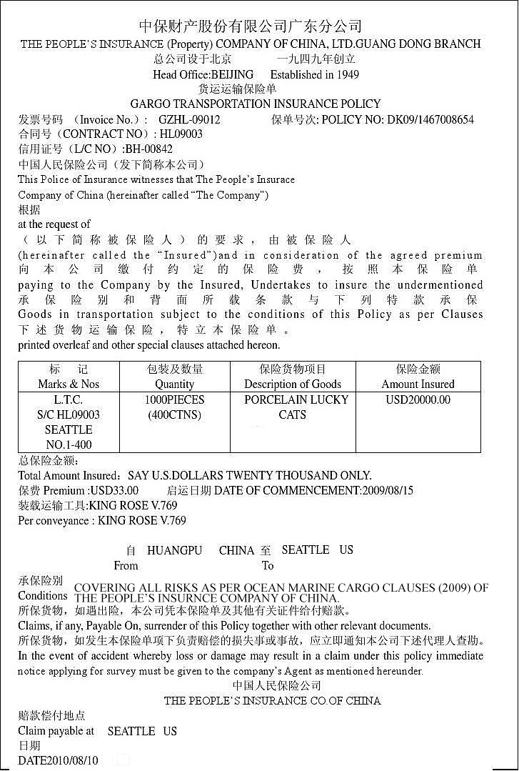

Insurance Policy
Sample Cargo Transportation Insurance Policy issued by PICC Guang Dong Branch

Slide 13
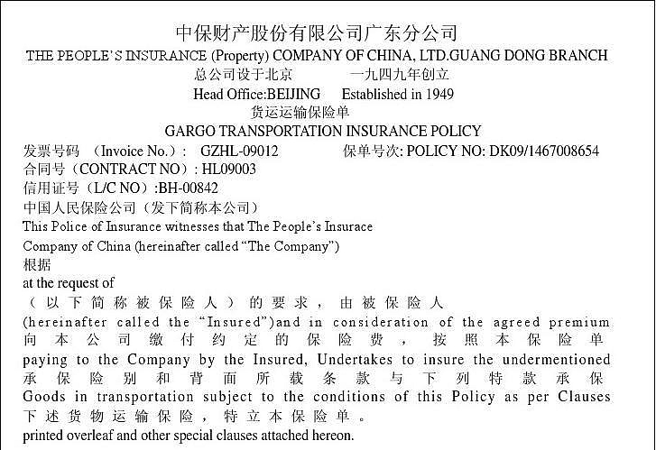
Name of the Insurer
Policy Number
Invoice No.
Contract No.
L/C No.
Description

Slide 14
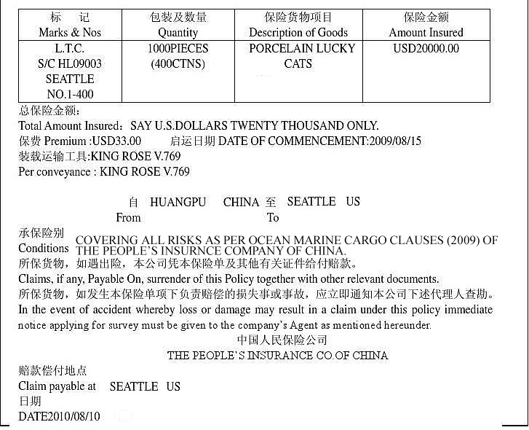
Cargo Details
Insured Amount
Premium
Voyage Details
Conditions
Claim Payable at
Date of Issuance and Signature

Slide 15
12.6 Claims
If goods are damaged or lost during transit, the insured or his agent should take the following steps to settle claims:
Inform insurer and apply for survey (理赔检验)
Survey and claim settlement agent
理赔检验代理人
Make claims for damages against the parties concerned
Carrier, Customs, Port Authorities

Slide 16
Take proper measures
Salvaging, preventing or minimizing damage
or loss
Prepare documents for claims
  Insurance policy or certificate
  Bill of lading
  Invoice
  Packing list
  Cargo damage or loss report
  Cargo survey report
  Statement of the claim

Slide 17
The Time of Validity of A Claim
Ocean Marine Cargo Clauses of PICC
Not exceed two years from the time of discharge
Port of Discharge
Two Years
Invalid after this point

Slide 18

Conditions for Making A Claim
The claimed losses must be caused by the risks falling into the coverage of the Insurance Policy.
The Insured must be the legal holder of the Insurance Policy.
The Insured must have insurable interests in the subject matter.

Slide 19
Thank You

