Slide 1

Chapter 11
Ocean Marine Cargo Clauses

Slide 2

11.1 Introduction
11.2 Risks and Losses in Cargo Transport
11.3 China Insurance Clauses (CIC)
11.4 Institute Cargo Clauses (ICC)
Contents

Slide 3
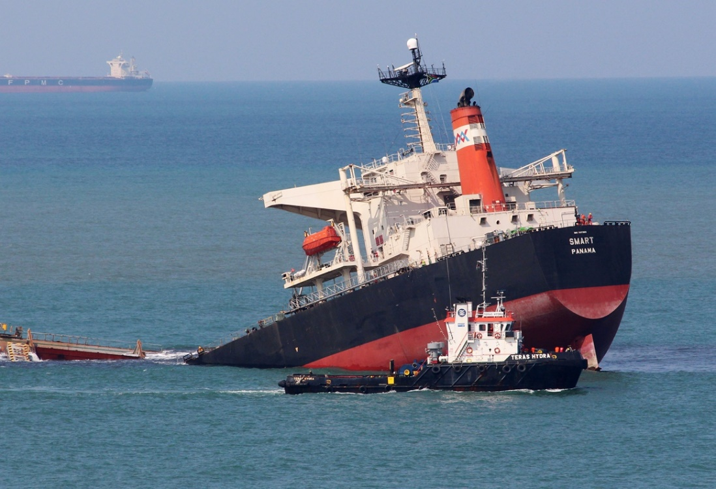
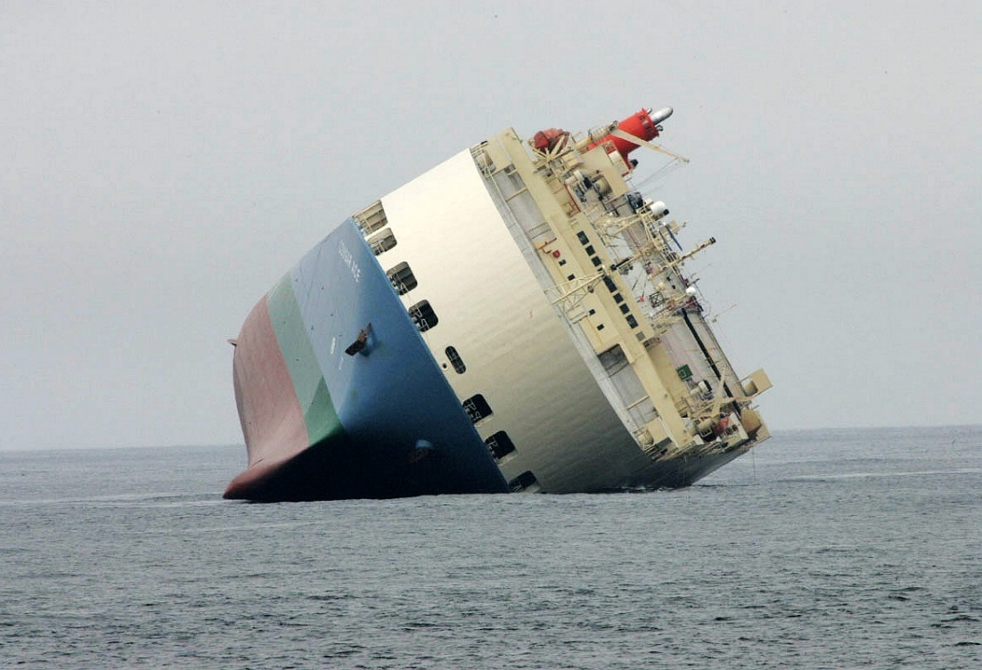
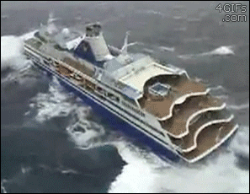
11.1 Introduction
What is marine cargo insurance?
Why we need marine cargo insurance?

Slide 4
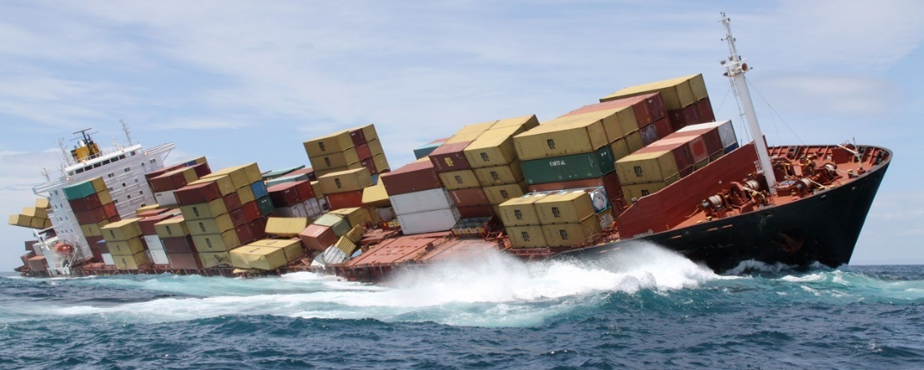

Concepts in cargo insurance
  Insurer and insured
  Insurance policy
  Premium
  Subject matter

Slide 5
Principles of Insurance
  Insurable interest 保险利益原则
  Utmost good faith 最大诚信原则
  Proximate cause 近因原则
  Indemnity 补偿原则
      Subrogation 代位求偿原则
      Contribution 重复保险分摊原则
  Mitigation 减少损失原则

Slide 6
Insurable interest
  The insured must have insurable interest in the subject matter of insurance
  No insurable interest ➔ void policy
  Examples: value of the goods, insurance premium, freight, expected profit, …
  Marine insurance: at the time of loss, the insured needs to have insurable interest

Slide 7

Utmost good faith
  Maximum honesty and fairness
  Each party must reveal all material information to the other party
  No fraud, non-disclosure or misrepresentation of
  material facts
  What are material facts?

Slide 8

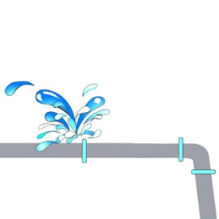
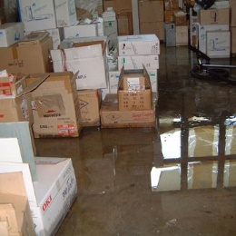
Proximate cause
  The nearest cause insured against that is responsible for a loss or damage
  It needs not be the cause immediately before the loss or damage occurs
Proximate Cause
Insured against fire
Burst pipe
Water damage
Not insured against

Slide 9


Indemnity
  The insured will be compensated only up to the extent of loss suffered
  After indemnity, the insured not better or worse than he was before the loss
  Exception for marine insurance: expected profit margin allowed
  Subrogation
  Contribution

Slide 10

Mitigation
  Insured to take reasonable action to keep loss to a minimum, as if the asset was not insured
  Responsibility of the insured to protect his insured asset and avoid further losses

Slide 11
11.2 Risks and Losses in Cargo Transport
Natural Calamities
Perils of the Sea
Fortuitous Accidents
Risks
General E.R.
Extraneous Risks
Special E.R.

Slide 12

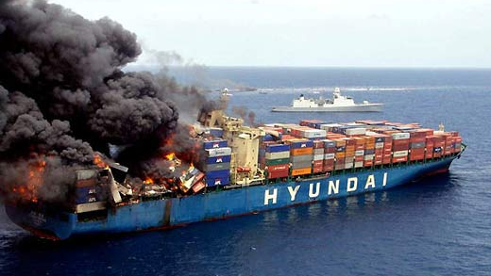
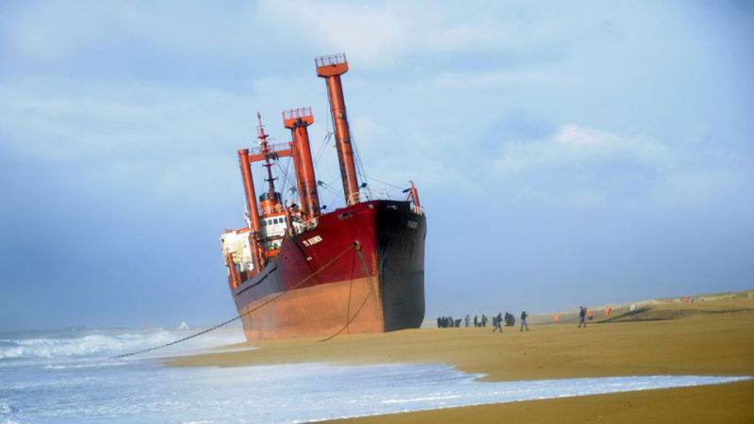
Perils of the Sea
Natural Calamities
  heavy weather, thunder storm and lightening, flood, earthquake, etc.
Fortuitous Accidents 意外事故
  - ship stranding, striking upon the rocks, ship sinking, ship collision, fire, explosion, etc.

Slide 13
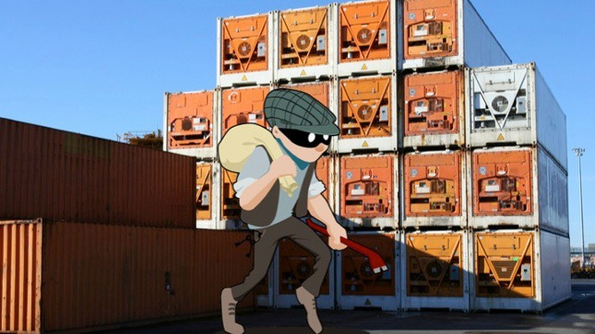
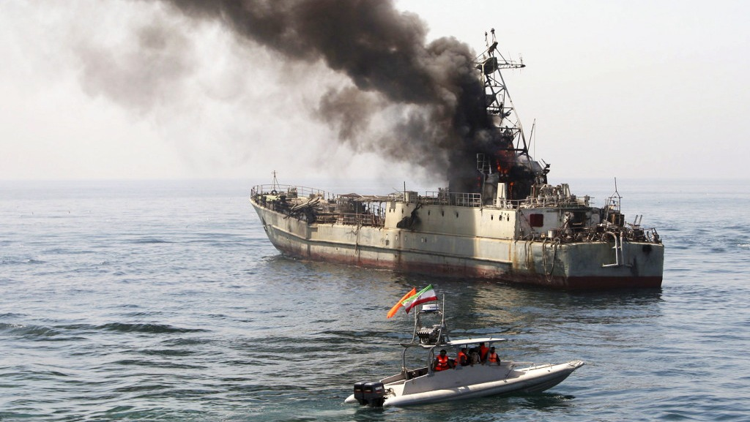
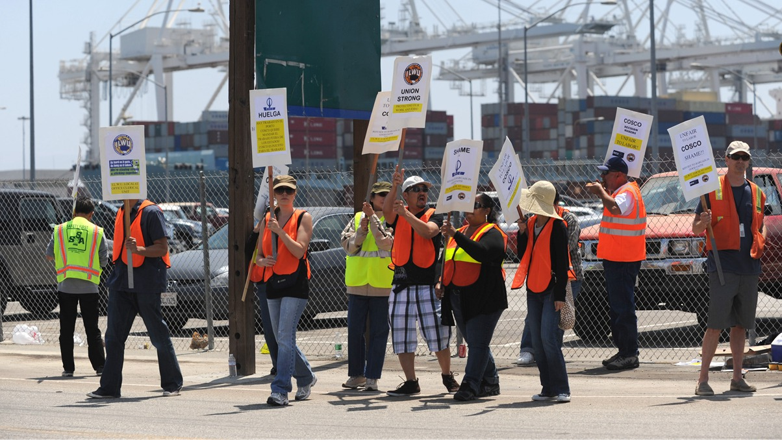
Extraneous Risks
General Extraneous Risks
  theft, rain, leakage, shortage, dampness, heating, hooking, rusting, etc.
Special Extraneous Risks 特殊外来风险
  war, strikes, failure of delivery and rejection,
  etc.

Slide 14
Actual Total Loss
Total Loss
Constructive Total Loss
Losses
General Average (G.A.)
Partial Loss
Particular Average (P.A)

Slide 15
Total Loss
Actual Total Loss
  cargo has been totally lost or has been damaged to the extent that it has lost its original usage
Constructive Total Loss
- an actual total loss appears to be unavoidable or the costs of restoration of the goods and the forwarding cost exceed their value on arrival

Slide 16
Partial Loss
General Average (GA)
  an intentional and reasonable sacrifice of the ship, freight, or cargo, or expenses incurred to rescue a ship and its cargo from danger or for the common safety of the ship and the consignment.
Particular Average (PA)
- a partial loss of a particular consignment caused directly by perils of the sea.

Slide 17
Compare GA and PA
Causes
GA is caused by deliberate measures for the rescue of the common interest.
PA is usually caused directly by perils of the sea.
Indemnification
GA should be contributed among all parties benefited from the deliberate measures in the proportion of the value of their goods.
PA of cargos is usually borne by the party whose cargo has been damaged.

Slide 18
Conditions of General Average
Danger threatening common safety materially exists, not foreseen.
Measures shall be taken deliberately & reasonably for common interest.
Sacrifice is extraordinary and expenses are extra. Sacrifice shall not be caused by perils directly.
Actions shall be successful in saving the voyage.

Slide 19
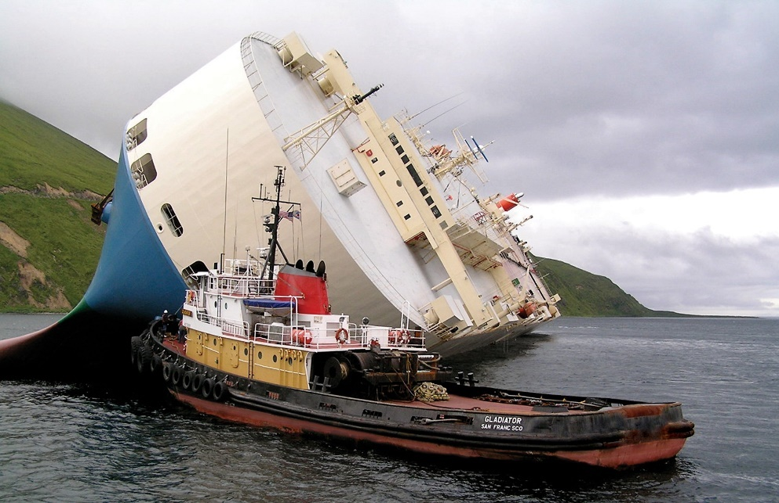
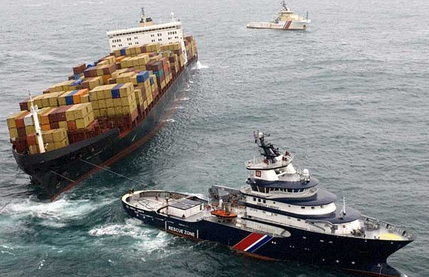
Sue and Labor Expenses
Expenses
Salvage Charges

Slide 20
Sue and Labor Expenses
any reasonable expenses incurred by the insured in order to minimize or avert a loss to the insured property.
Salvage Charges
recoverable charges made to those other than the insured, the carrier and the insurer who come to the salvage of the ship and the consignments.

Slide 21

11.3 China Insurance Clauses (CIC)
The Ocean Marine Cargo Clauses of China Insurance Clauses issued by The People’s Insurance Company (Group) of China (PICC).
Revision 2009

Slide 22
Scope of Cargo Insurance Coverage
Basic Coverage
FPA 平安险
WPA 水渍险
AR 一切险
Additional Coverage
General Additional
Coverage
Special Additional
Coverage

Slide 23
FPA (Free from Particular Average)
Coverages:
  Total Loss caused by Natural Calamities
  Total Loss and Partial Loss caused by
  Fortuitous Accidents
  Costs of salvaging, using Port of Distress (避难港) and Contributions to GA, etc.
Minimum coverage
For cheap and bulk cargos, such as iron scrap, wood, ore, etc.

Slide 24
WPA (With Particular Average)
Coverages:
FPA + Partial Loss caused by Natural Calamities
Extended coverage
For goods may be damaged during transit but less likely lose their uses due to the damages, such as metal products, chemicals, wood products and used cars, etc.

Slide 25
AR (All Risks)
Coverages:
WPA + Total Loss and Partial Loss caused
by General Extraneous Risks
Most comprehensive coverage
AR excludes losses caused by Special Extraneous Risks and Exclusions
For goods prone to damages during transit, such as manufactured goods, high-value goods, etc.

Slide 26
Exclusions
Loss or damage caused by the intentional act or fault of the insured;
Loss or damage falling under the liability of the consignor;
Loss or damage from the inferior quality or shortage of the insured goods before the insurance policy becomes effective;
Loss or damage from normal loss, inherent vice or nature of the insured goods, loss of market and/or delay in transit;
Risks and liabilities covered and excluded by the war risks clause and strikes clauses under CIC Exclusions.

Slide 27
Commencement and Termination
Warehouse to Warehouse Clause, W/W.
Warehouse
Port
Warehouse
START
END
END

Slide 28
Warehouse to Warehouse Clause, W/W.
Warehouse
Port
60 Days
START
END
END

Slide 29
General Additional Coverage
Cover losses caused by General Extraneous Risks Eleven (11) Types
Theft Pilferage and Non-Delivery;
Rain Fresh Water Damage;
Risk of Shortage;
Risk of Intermixture and Contamination;
Risk of Leakage;
Risk of Clash and Breakage;
Risk of Odour;
Damage Caused by Sweating and Heating;
Hook Damage;
Risk of Breakage of Packing;
Risk of Rust.

Slide 30
Special Additional Coverage
Cover losses caused by Special Extraneous Risks Eight (8) Types
War Risks;
Strike Risks;
Aflatoxin;
Failure to Deliver;
On Deck;
Import Duty;
Rejection;
Fire Risk Extension Clause - for Storage of Cargo at Destination Hong Kong, Including Kowloon, or Macao 货物出口到香港(含九龙)或澳门存仓火险责任扩展条款.

Slide 31
Summary of Basic and Additional Coverages
AR Total Loss and Partial Loss by General
Extraneous Risks
WPA Partial Loss by Natural Calamities
FPA
Scope of Coverage: AR>WPA>FPA
AR = WPA+ General Additional Coverage
FPA, WPA or AR can be insured independently
Additional Coverages have to be taken with Basic Coverages

Slide 32
Case Study
A cargo ship bound from Shanghai, China to Busan, Korea caught fire on the voyage. Because fire spread to the cargo hold, the captain, for the sake of the common safety ordered water being pumped into the cargo hold, then the fire was quickly put out. However, as the main engine was damaged by fire, the ship was unable to continue sailing. The captain hired a tug boat to tow the cargo ship to a nearby port for repair and headed to the final destination – Busan, Korea.

Slide 33



The losses and expenses of the accident are
500 out of 1,000 boxes of kitchenware were destroyed by fire
400 out of 600 cases of T-shirt were water-soaked
200 out of 500 boxes of laptop computers were burned by fire and also water-soaked
Damaged main engine
Towing costs
Extra fuel costs and crew wages

Slide 34
What are the nature of the losses and expenses?
Partial Loss
- General Average
2. 5. 6.
cause by action for common interests
Partial Loss
- Particular Average
1. 3. 4.

Slide 35
What kind of CIC insurance should be taken to cover these losses and expenses?
FPA of CIC is sufficient to cover the losses and expenses in the example because
Fire is Fortuitous Accidents
FPA covers Total Loss and Partial Loss caused by Fortuitous Accidents

Slide 36
Duties of the Insured
According to Ocean Marine Cargo Clauses, the insured shall:
Take delivery of the insured goods timely.
Take reasonable measures in salvaging the goods.
Notice the insurer about the change of voyage and omission or error in the description of the interest.
Provide relevant documents to accompany any claim.
Promptly notice the insurer about cargo owner’s responsibility under “Both to Blame Collision” clause.
The insurer reserves the right to reject insured’s claim for any loss if the insured fails to fulfil the duties.

Slide 37

Insurance of Land, Air and Parcel Post Transport
Overland Transport Risks
Can be insured independently
Overland Transport Cargo Insurance
Overland Transport All Risks
Overland Transport Cargo War Risks
To be taken with above insurance

Slide 38
Air Transport Risks
Can be insured independently
Air Transport Cargo Insurance
Air Transport All Risks
Air Transport Cargo War Risks
To be taken with above insurance

Slide 39
Parcel Post Risks
Can be insured independently
Parcel Post Insurance
Parcel Post All Risks
Parcel Post War Risks
To be taken with above insurance

Slide 40


11.4 Institute Cargo Clauses (ICC)
Widely adopted worldwide in the international insurance industry
Published by the Institute of London Underwriters in 1912
Most recent version: 2009

Slide 41
ICC (A)
- Covers all risks of physical loss or damage
- Subject to certain exclusions
ICC (B)
- Covers physical loss or damage caused by natural
calamities and fortuitous accidents
- Subject to certain exclusions
ICC (C)
Most restrictive coverage, subject to certain exclusions
>
>
ICC (A)
ICC (B)
ICC (C)

Slide 42
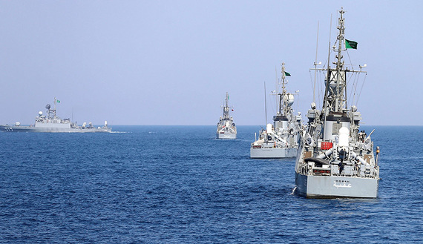
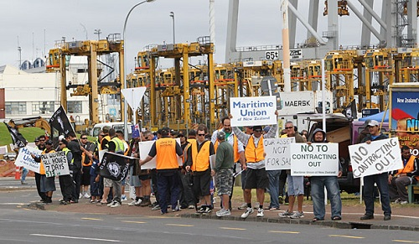
Institute War Clauses – Cargo
Institute Strikes Clauses – Cargo
Like ICC (A), ICC (B) and ICC (C), War Clauses and Strikes Clauses can be taken independently.

Slide 43
Malicious Damage Clauses
Institute Theft, Pilferage and Non-delivery Clauses
They are additional coverages to ICC (B) and ICC (C).
ICC (A) includes these two clauses.
These two clauses cannot be taken independently.

Slide 44
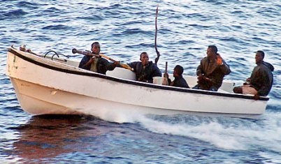
Compare ICC and CIC
ICC (A)
correspond to
AR
ICC (B)
correspond to
WPA
ICC (C)
correspond to
FPA
ICC (A)
YES
Malicious Damage
NO
AR

Slide 45
Thank You

