Slide 1

Chapter 10 Terms of Shipment

Slide 2

10.1 Time of Shipment
10.2 Port of Shipment
10.3 Port of Destination
10.4 Partial shipments
10.5 Transshipment
10.6 Advice of Shipment
Contents

Slide 3
10.1 Time of Shipment
Difference between “Time of shipment” and “Time of delivery”
Under trade terms: FOB, CFR and CIF
Time of shipment = Time of delivery
Under trade terms: DAP, DAT and DDP
Time of shipment ≠ Time of delivery

Slide 4
Shipment during June/July/August
JUN
JUL
AUG
Shipment not later than July 31, 2017
31
Shipment within 30 days after receipt of L/C
L/C
30 Days

Slide 5
10.2 Port of Shipment
World Rank | Name | Container Traffic 2015 (in thousand TEUs)
1 | Shanghai | 36,516
3 | Shenzhen | 24,142
4 | Ningbo-Zhoushan | 20,636
5 | Hong Kong | 20,073
7 | Qingdao | 17,323
8 | Guangzhou | 17,097
10 | Tianjin | 13,881
https://en.wikipedia.org/wiki/List_of_busiest_container_ports

Slide 6
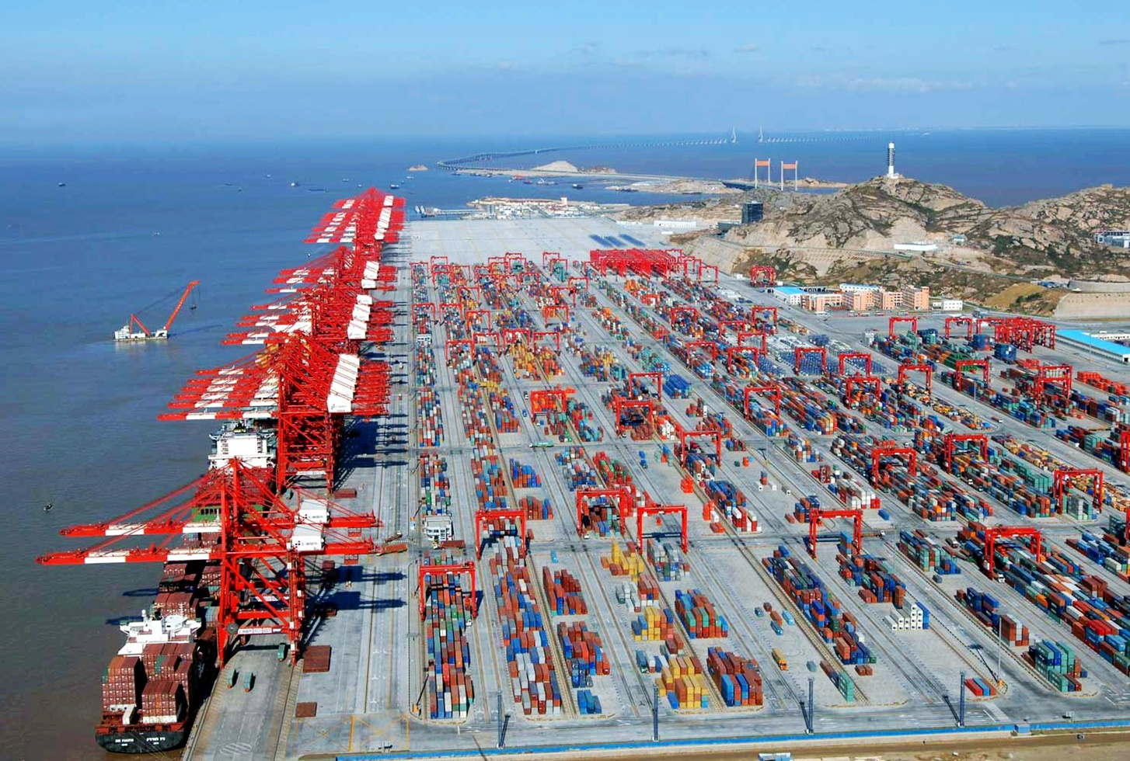
Port of Shanghai

Slide 7
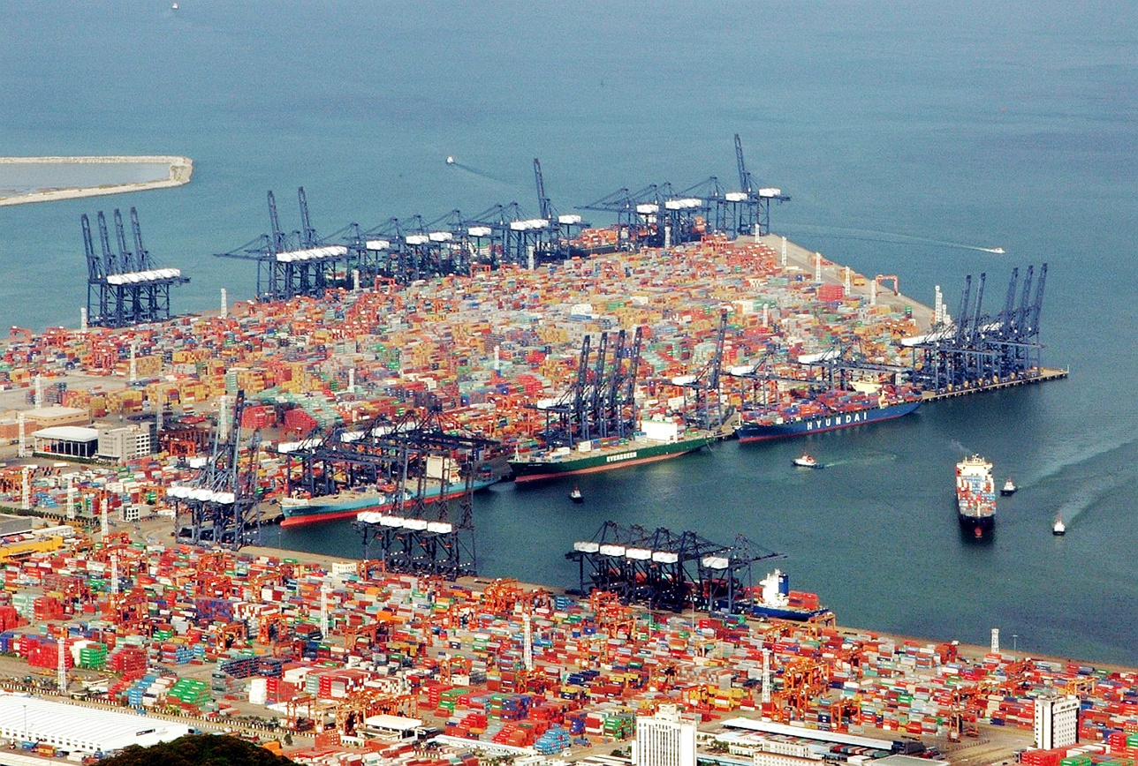
Port of Shenzhen

Slide 8
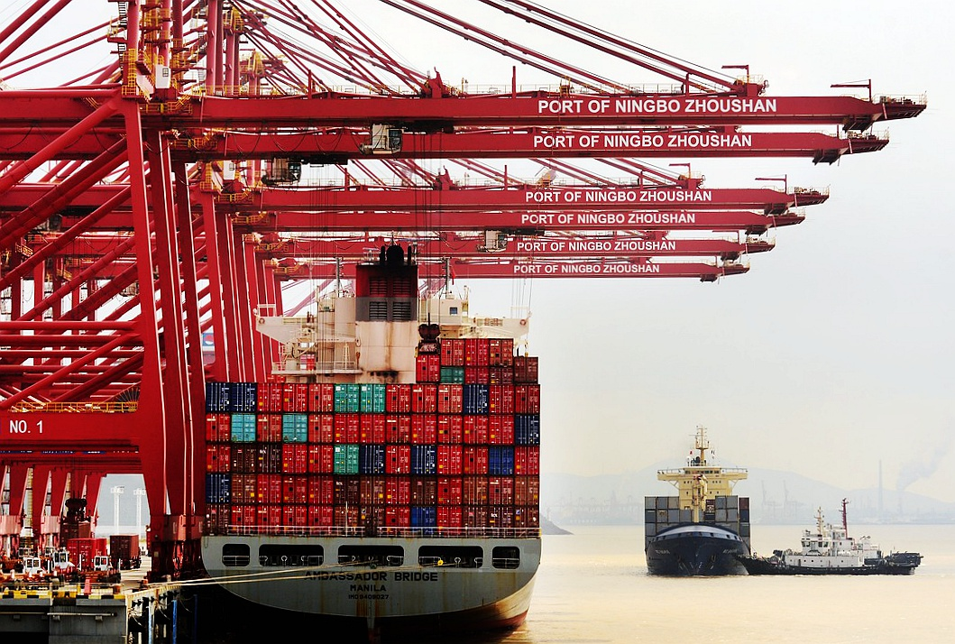
Port of Ningbo

Slide 9
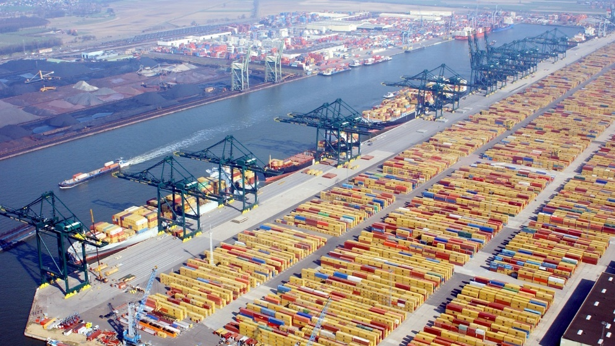
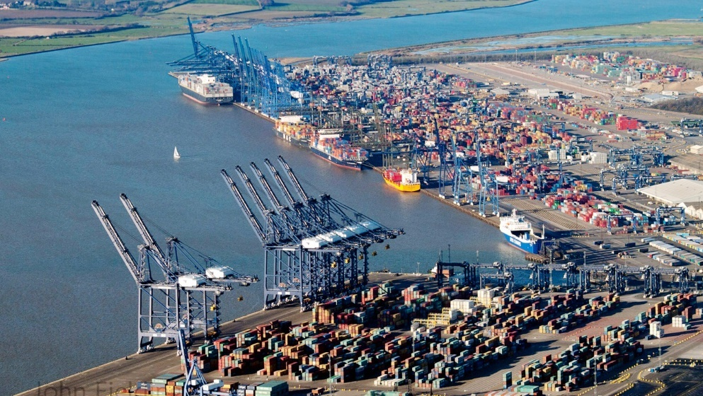


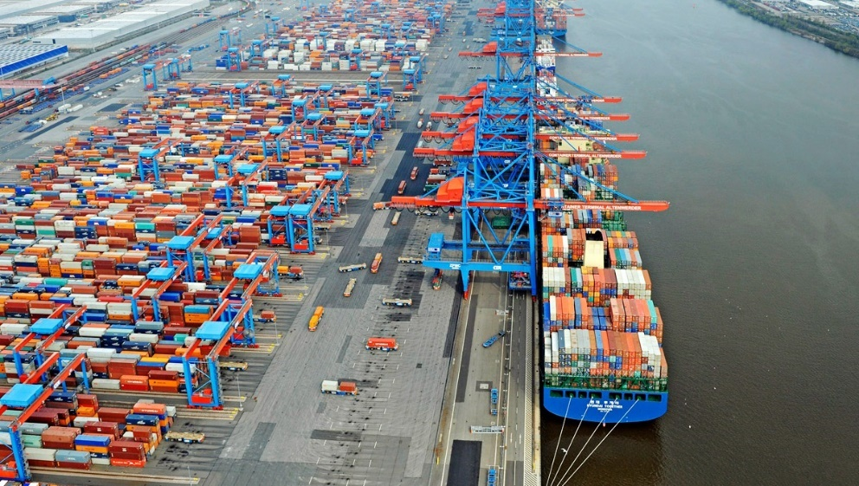
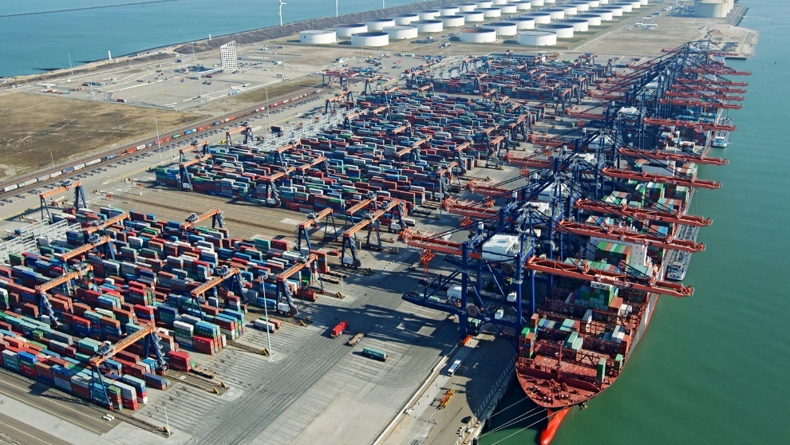


10.3 Port of Destination
Main Ports in Europe
Antwerp
Felixstowe
Hamburg
Rotterdam

Slide 10
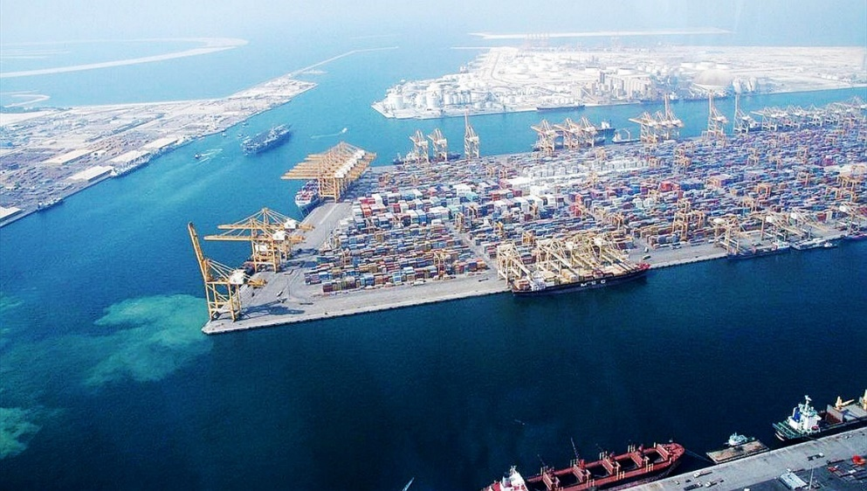
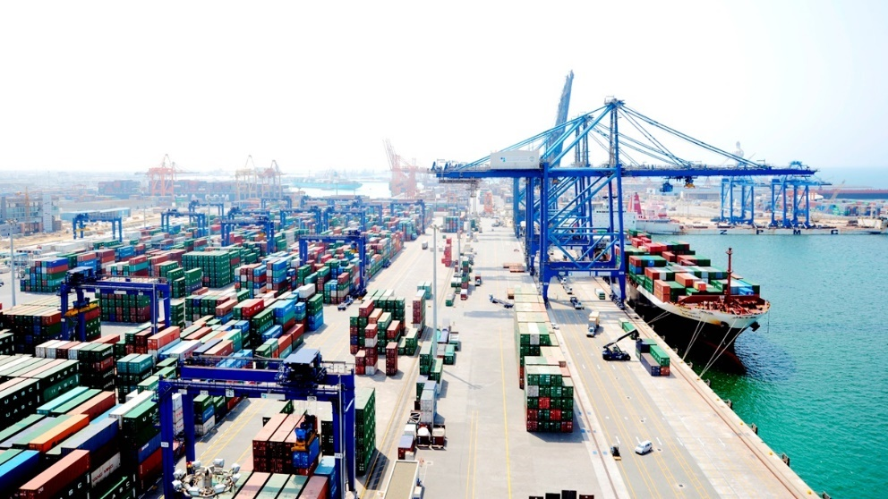


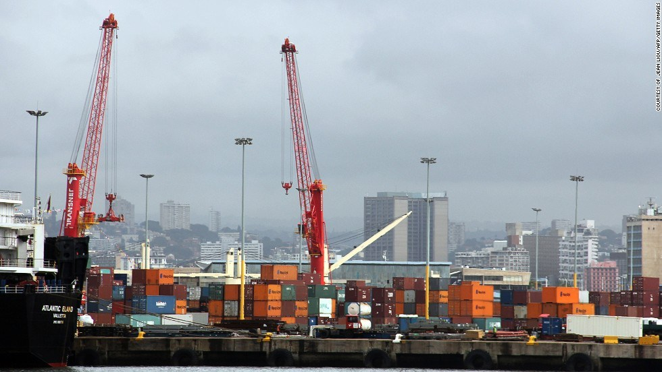
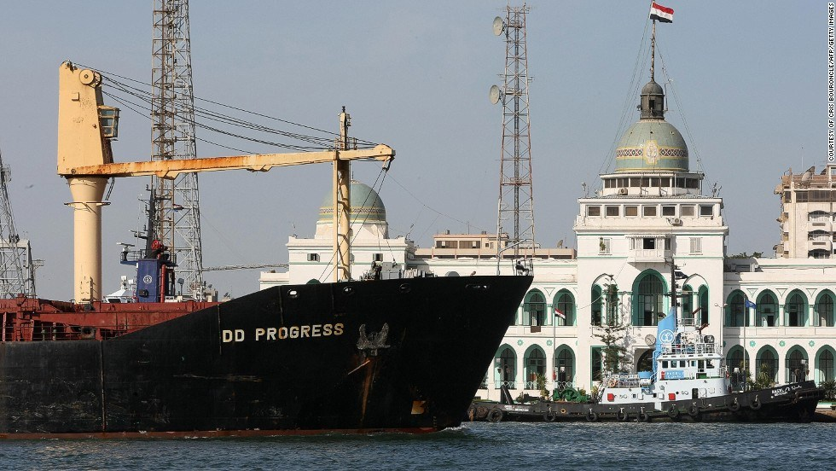


Main Ports in Mid-East and Africa
Jebel Ali
Jeddah
Durban
Port Said

Slide 11
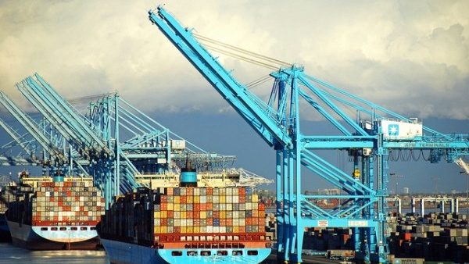
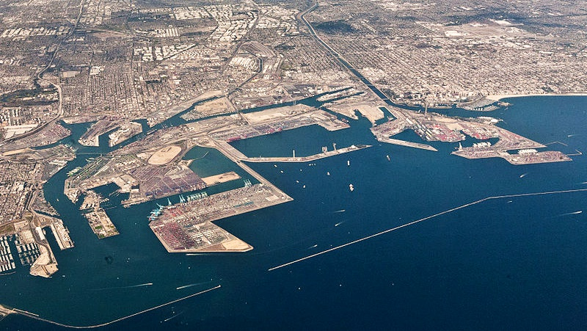

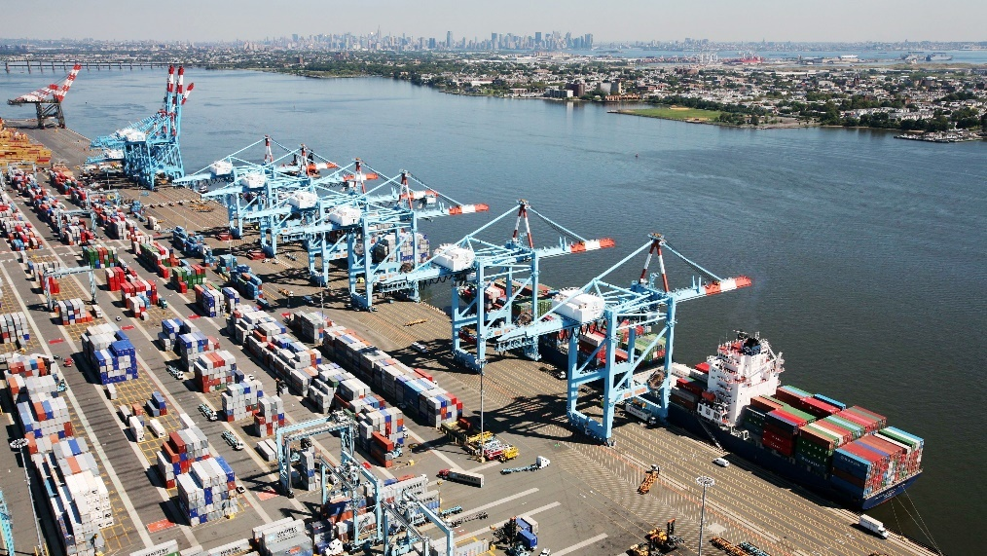
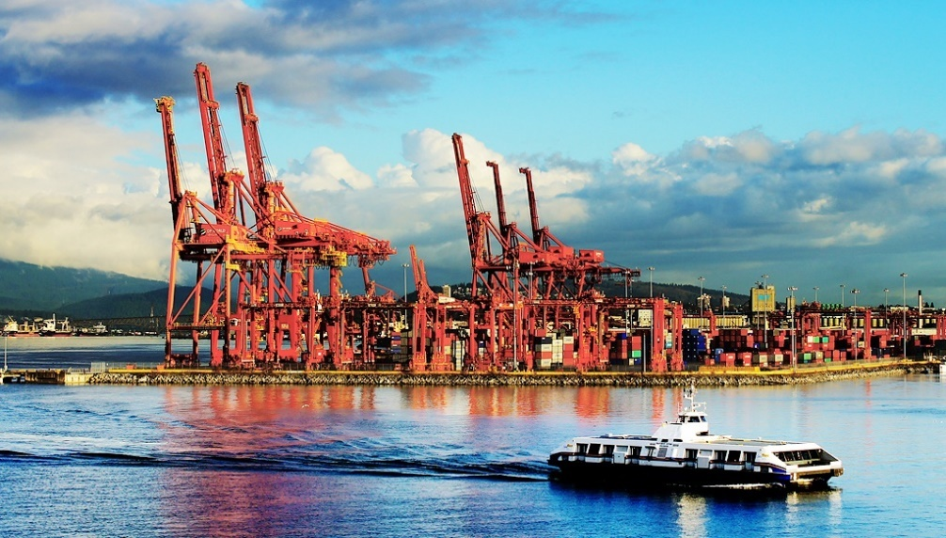

Main Ports in North America
Long Beach
Los Angeles
New York and
New Jersey
Vancouver

Slide 12


10.4 Partial Shipments
UCP 600 Article 31
Partial shipments are allowed.
Different Ships
Same Destination
Same Day
Ship A
APR 5
Ship B
APR 5
Port A
Ship C
APR 5
Partial Shipments

Slide 13
UCP 600 Article 31
Not Partial Shipments
APR 1
Same Ship
Same Destination
Port A
APR 6
Port B
Date of Shipment
APR 9
Port C
Port D
Not Partial Shipments

Slide 14
UCP 600 Article 32
Any installment not drawn or shipped, credit ceases to be available.
L/C
“Shipments in Apr/May/Jun”
Ship A
APR
Port A
Ship B
MAY
Payment
Ship C
JUN
$Apr
$May
$Jun

Slide 15
10.5 Transshipment
Different Ships
Same Mode of Transport
Port A
Transshipment
Port C
Port B

Slide 16
Multimodal Transport
Different Means of Conveyance
Different Modes of Transport
Port A
Transshipment
Port B
Consignee

Slide 17
10.6 Advice of Shipment
Advice
Seller
Buyer

Slide 18
Thank You

