Slide 1

Chapter 9
Other Modes of Transport

Slide 2

9.1 Other Modes of Transport
9.2 Shipping Documents
Contents

Slide 3
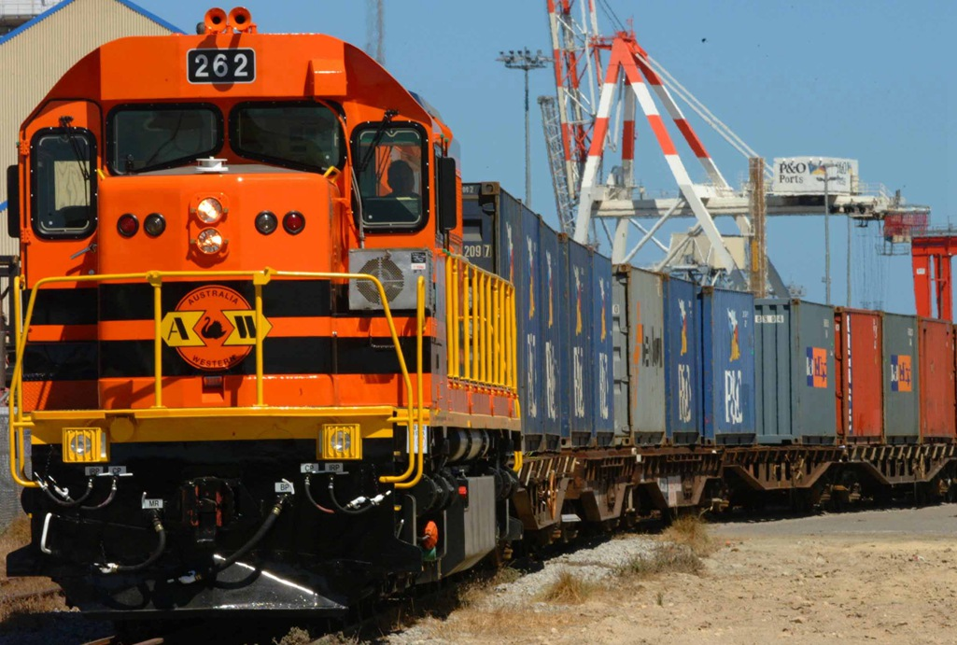
Railroad Transport
9.1 Other Modes of Transport

Slide 4
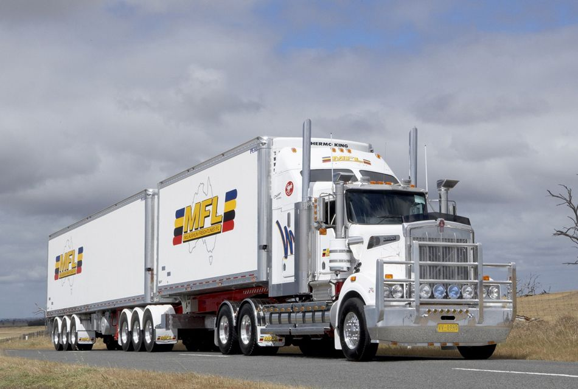
Road Transport

Slide 5

Air Transport

Slide 6

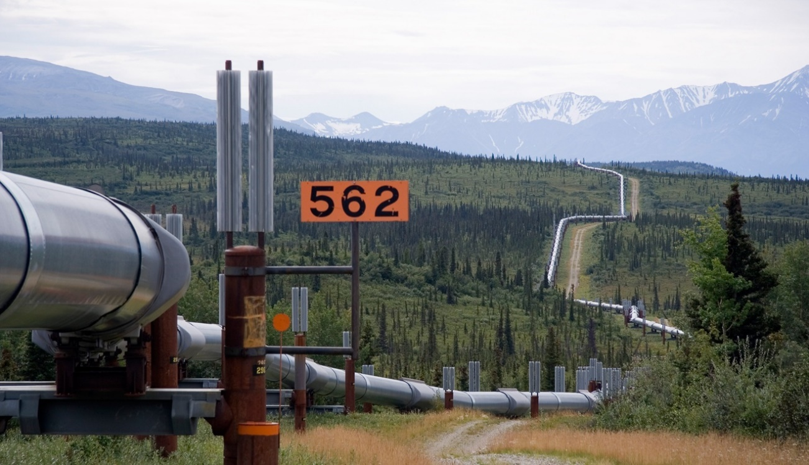
Intermodal Transport
Pipeline Transport

Slide 7
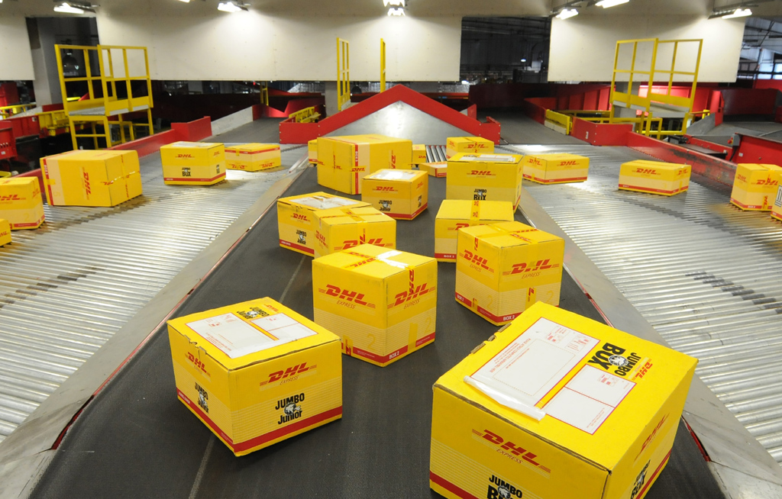
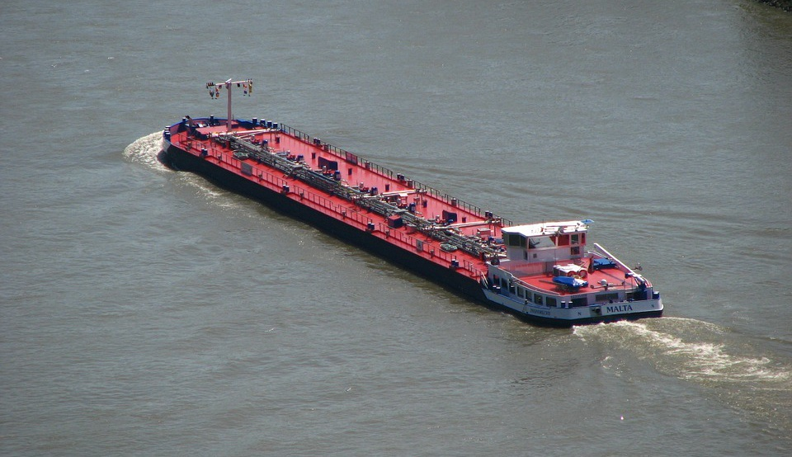
Parcel Post Transport
Inland Waterway Transport

Slide 8
9.2 Shipping Documents
Railway Bill
Multimodal Transport Document
Airway Bill
Parcel Post Receipt

Slide 9
Thank You

