Slide 1

Chapter 8 Ocean Transport

Slide 2

8.1 Ocean Transport
8.2 Shipping Services of Ocean Transport
8.3 Container Shipping
8.4 Shipping Documents
Contents

Slide 3
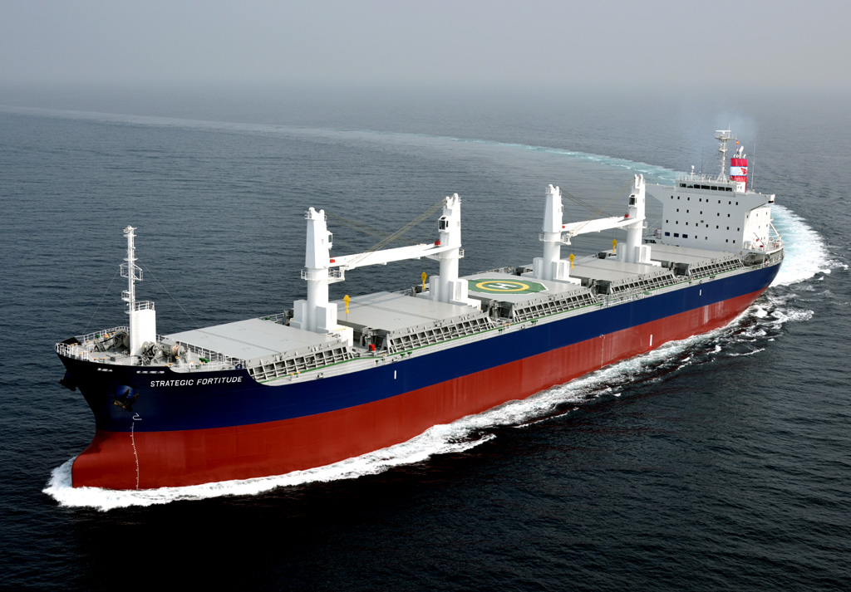
8.1 Ocean Transport

Slide 6
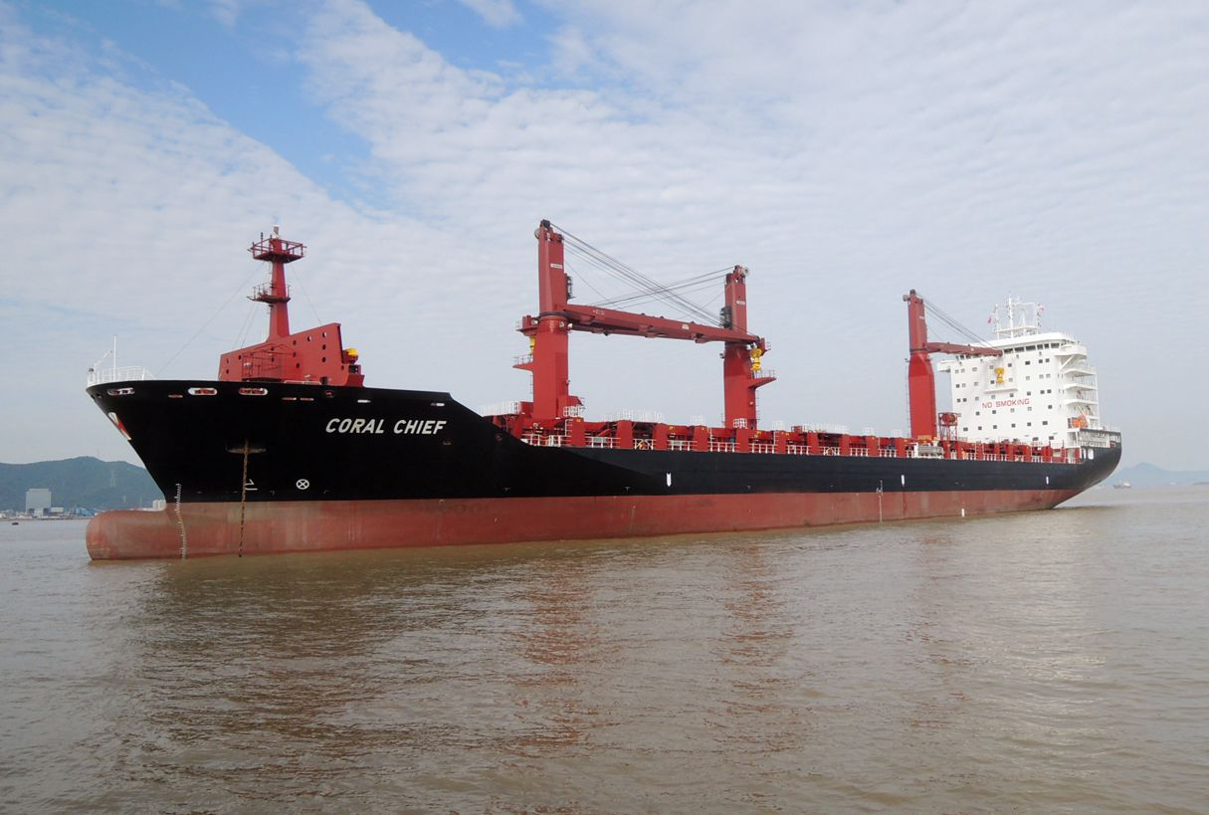
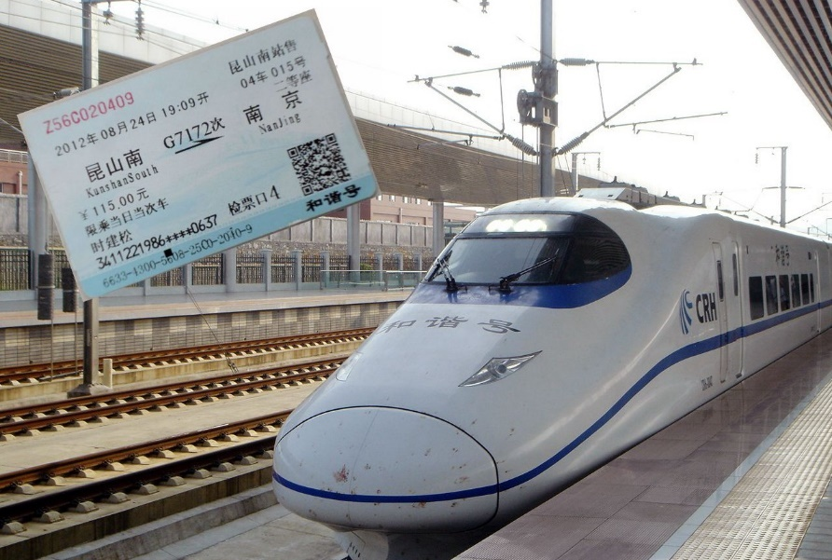
8.2 Shipping Services of Ocean Transport
Liner
Analogous to train service
Regular route by schedule
Fixed tariff

Slide 7
Liner Freight
Basic Freight
Surcharges

Slide 8
Standards of Basic Freight Rates
Basis | Note
Weight Ton (W) | Per metric ton | Freight Ton
Measurement Ton (M) | Per cubic meter
W/M | By weight ton or by measurement ton, whichever is the higher
Ad. Val | Based on value of cargo
W/M or Ad. Val | Use whichever is the highest
W/M plus Ad. Val, Unit, Open Rate, Minimum Rate (per B/L)

Slide 9
Surcharges
Bunker Adjustment Factor (BAF)
Port Congestion Surcharge
Terminal Handling Charges
Currency Adjustment Factor
……

Slide 10
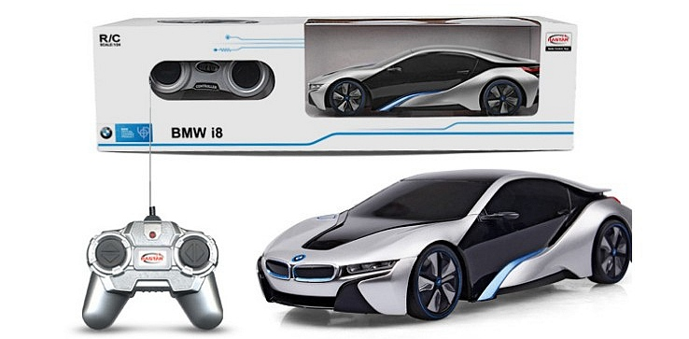
Case Study
Calculation of Liner Freight
A Chinese trading company exports 100 cases of remote controlled model cars from Shanghai to Singapore. The dimensions and gross weight of each case are 60cm*50cm*30cm and 20kg. How much is the total freight?

Slide 11
1. Determine the class and basis of basic freight rate
Scale of Commodity Classification
Commodity | Basis | Class
… | … | …
Toys, Electrically Operated | M | 10
Toys, Wooden, Metal, Plush | M | 8
… | … | …

Slide 12
2. Determine the basic freight rate and surcharge
Basic Freight Rate by Class (in US$) From Shanghai
Class | Port of Destination
 | Bangkok | Singapore
… | … | …
9 | 50.00 | 65.00
10 | 55.00 | 70.00
* Bunker Adjustment Factor 20%

Slide 13
3. Calculate volume
Basis = M
0.6*0.5*0.3*100 = 9 m³
Basic freight rate = US$70/cubic meter
BAF = 20%
4. Total Freight = Total Weight x (Basic Rate + Surcharge)
= 9x(70+70x20%)
= US$756

Slide 14
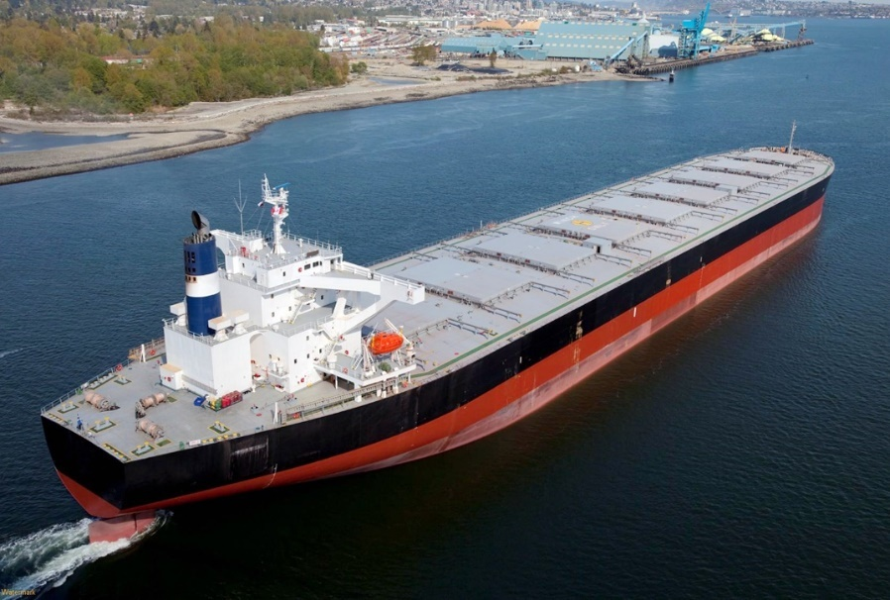
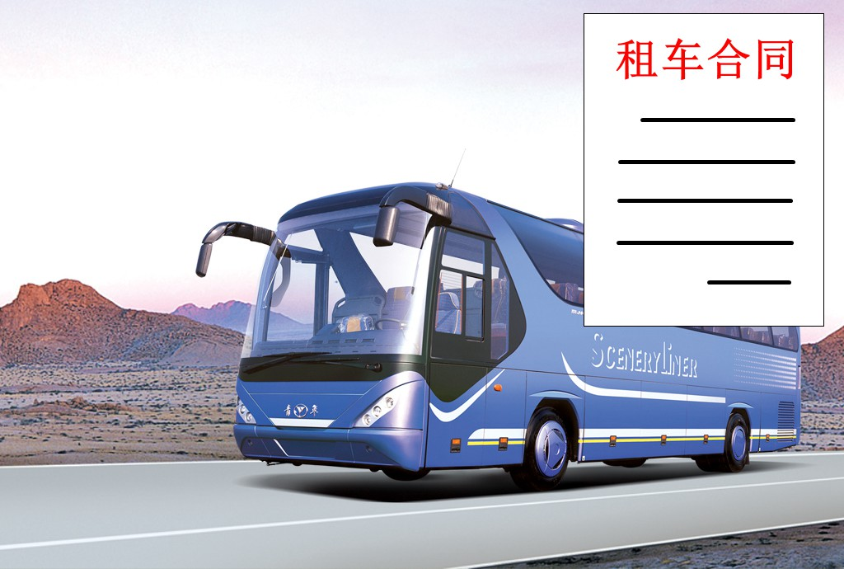
Chartering
Charter Party
Analogous to renting a coach
For bulk cargoes - oil, coal and grain, etc.
No fixed routes
Variable freight rates

Slide 15
Types of Charter
Voyage Charter 定程租船
Pay by Voyage
Time Charter 定期租船
Apr
Pay by Time
Oct
Time Charter on Trip Basis 航次期租
Pay by Time for Specific Trip
May
Jun

Slide 16
Terms for Voyage Charter
 | Ship owner pays for
Liner Terms | Loading and unloading, as in the liner service
FI (Free In) | Only unloading
FO (Free Out) | Only loading
FIO (Free In and Free Out) | Neither loading nor unloading
FIOST | Neither loading nor unloading, stowage and trimming

Slide 17
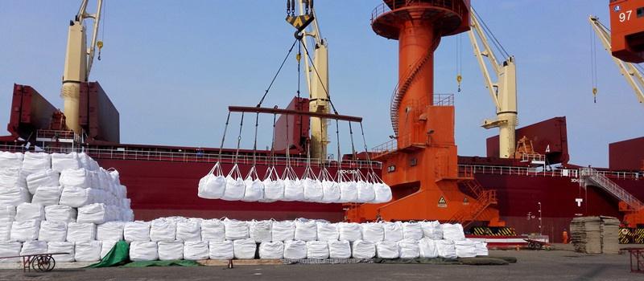
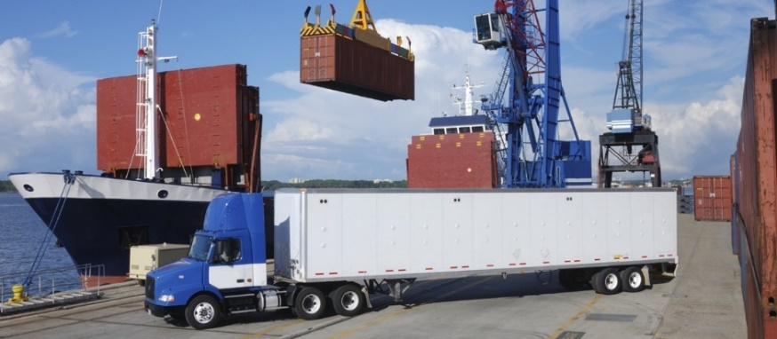
Reward for lay days saved
$ Despatch Money $
Shipper/
Charterer
Ship Owner
$ Demurrage $
Fine for lay days exceeded

Slide 18
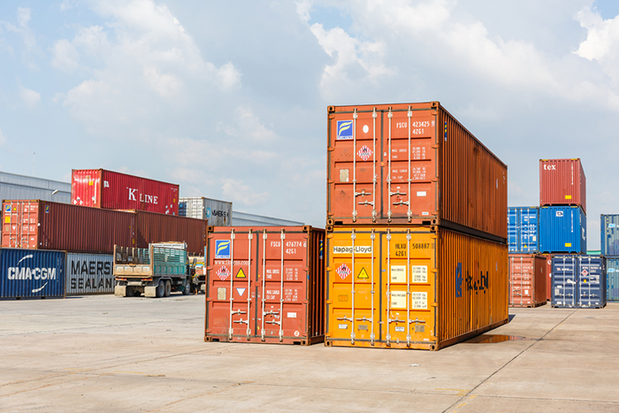
8.3 Container Shipping
Advantages
Standardization
Flexibility
Cost Reduction
Speed of Handling
No Warehousing
Improved Safety

Slide 19
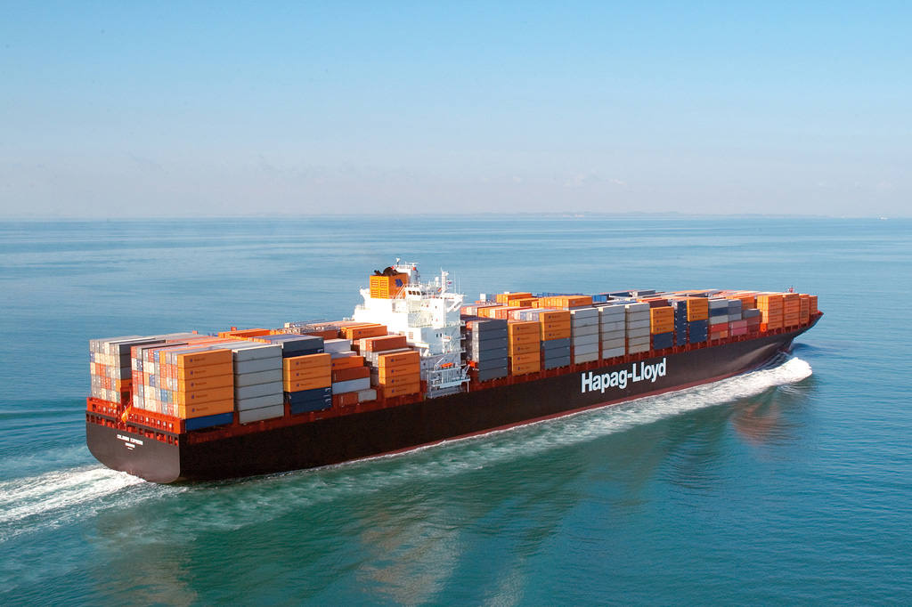
Weight of World Seaborne Trade, 2006
Value of World Seaborne Trade US$, 2006
Source: Lloyd’s Maritime Intelligence Unit(2009)

Slide 20
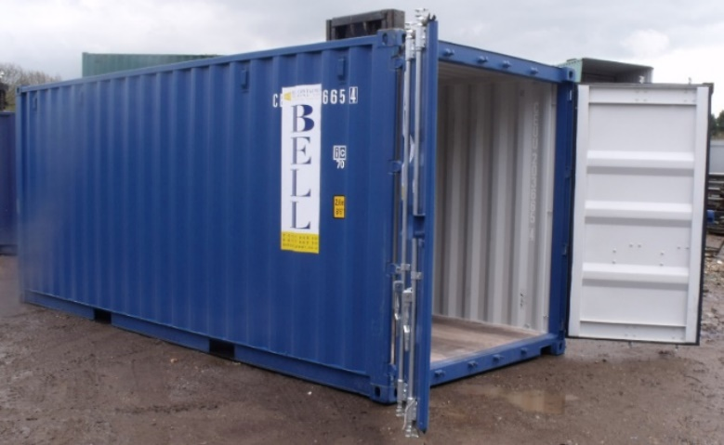
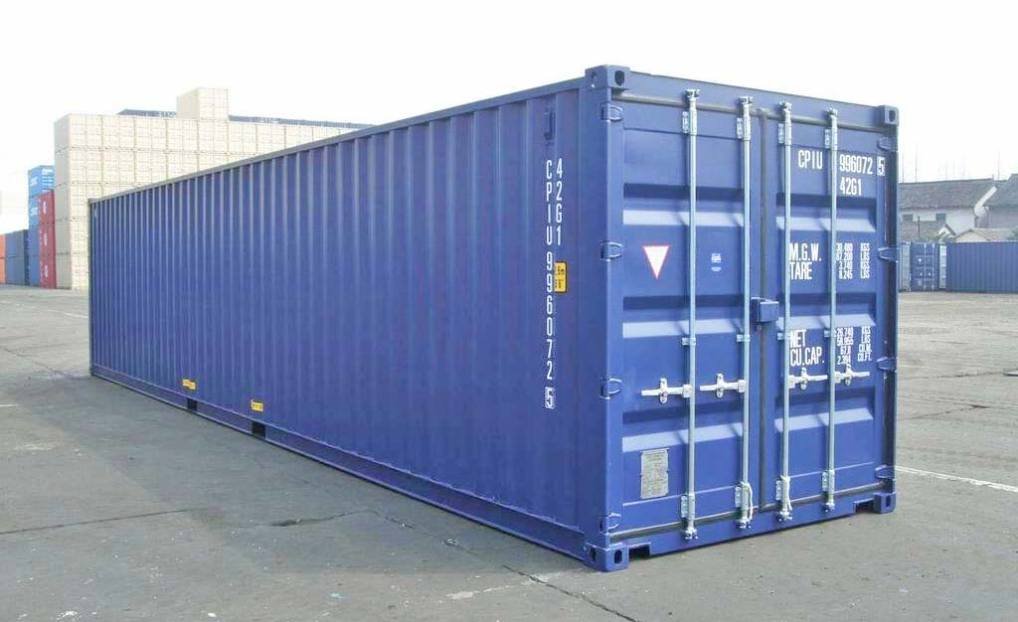
 | L 6.06m x W 2.44m x H 2.59m Internal Volume 33.1 m³ Net load 28.2 ton
20 ft dry freight container (ISO) | TEU = Twenty-foot Equivalent Unit
 | L 12.19m x W 2.44m x H 2.59m Internal Volume 67.5 m³ Net load 26.2 ton
40 ft dry freight container (ISO)
40 ft high-cube container (ISO) | H 2.90m, Net load 26.6 ton

Slide 21
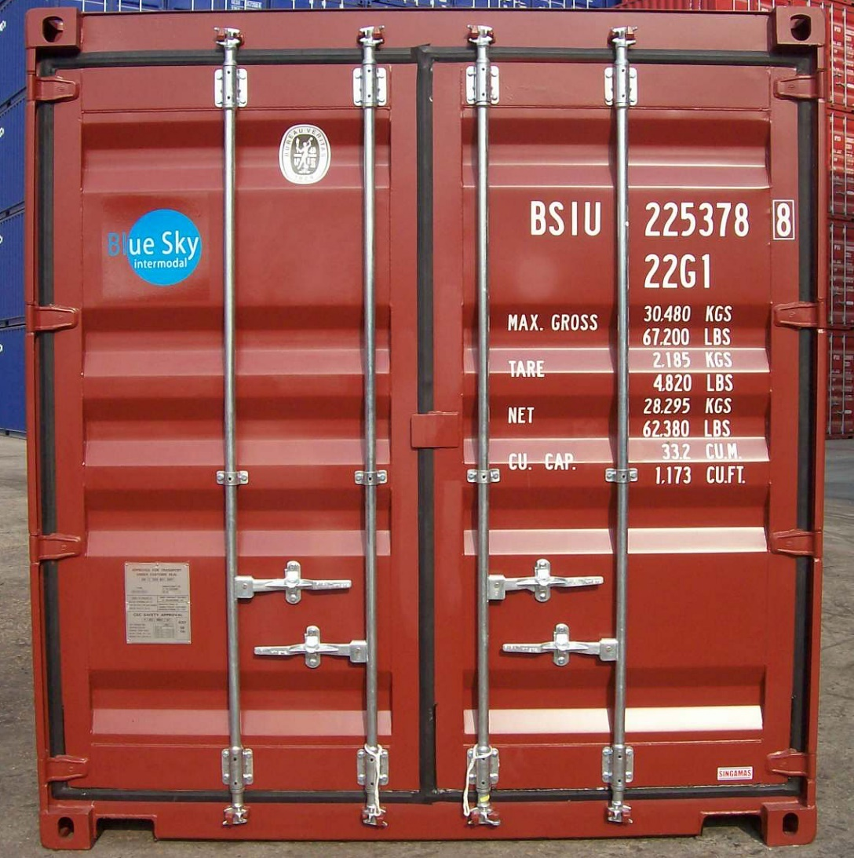
Owner’s Logo
Ownership Code
Size and Type Code
Max. Gross Weight
Tare
Net Payload
Capacity
22G1 = Unventilated GP Container
Vents in upper part of cargo space
CSC Safety-approval Plate

Slide 22
Full Container Load (FCL)
Exclusive use of the container
Less risks of damage or contamination
Unit cost lower than LCL
Less than Container Load (LCL)
Shipments not requiring a full container
Share a container with other people’s shipments
LCL costs more than FCL per unit of freight

Slide 23
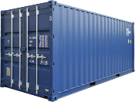
CY to CY
FCL
FCL
Carrier
Port
Shipper
Consignee
CY
CY
CY: Container Yard
Modes of Container Service

Slide 24
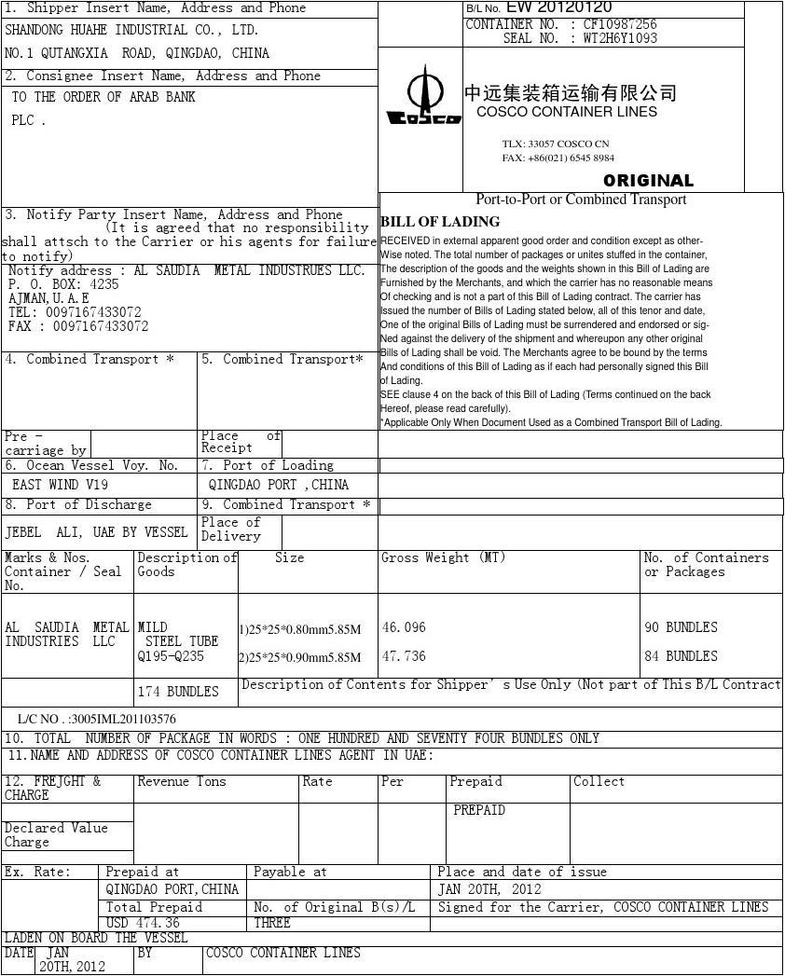
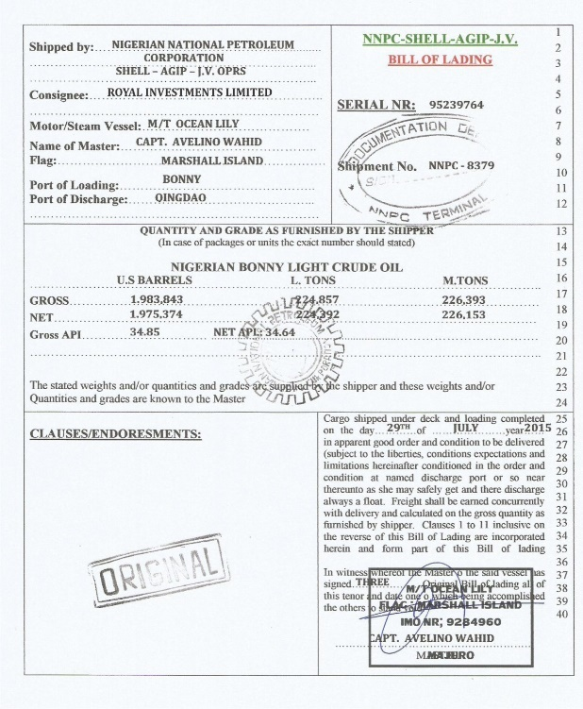
8.4 Shipping Documents
Bill of Lading

Slide 25
Functions of the B/L
Receipt for goods
Evidence of the contract of carriage
Document of title to the goods

Slide 26
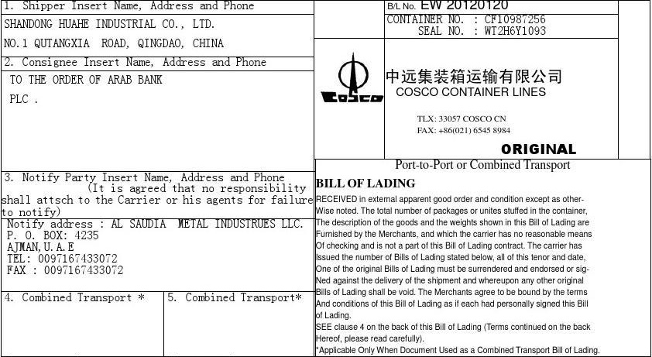
B/L Number
Carrier
Shipper
Consignee
Straight B/L
Order B/L
Bearer B/L
Notify Party
Original Container B/L

Slide 27
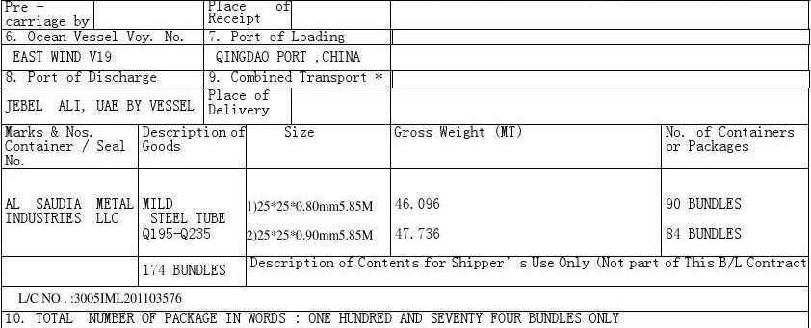
Port of Discharge
Port of Loading
Cargo Details
Vessel Name
L/C Number

Slide 28
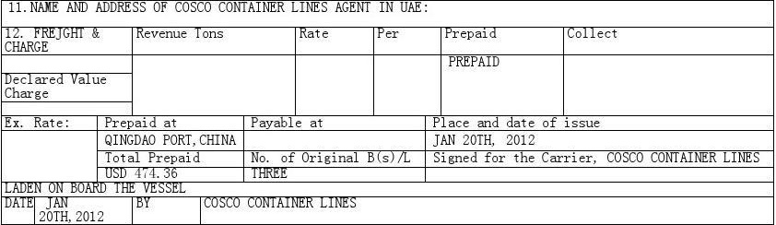
Prepaid or Collect
On Board B/L
Place and Date of Issuance and Signature

Slide 29
Types of the B/L
On Board B/L
Clean B/L
Bank Accepts an On Board and Clean B/L
Received for Shipment B/L
Unclean B/L
Banks Don’t Accepts These B/Ls
“two cartons missing”
“damaged crates”
“wet or stained cartons”

Slide 30
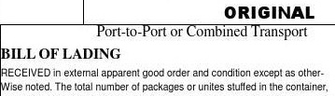


This is an Original, Clean, On Board B/L

Slide 31
Ante-dated B/L
10
12
12
09
L/C:
before the 10th
Actual Date of
Shipment
Date of Issuing An Ante-dated B/L
Advanced B/L
09
10
?
Date of Issuing An Advanced B/L
L/C:
before the 10th
Actual Date of
Shipment

Slide 32

Ante-dated and Advanced B/L
Frauds and willful misrepresentations
High risk
Buyer may reject goods and claim for damages
Good practice: ask the buyer to extend the L/C

Slide 33
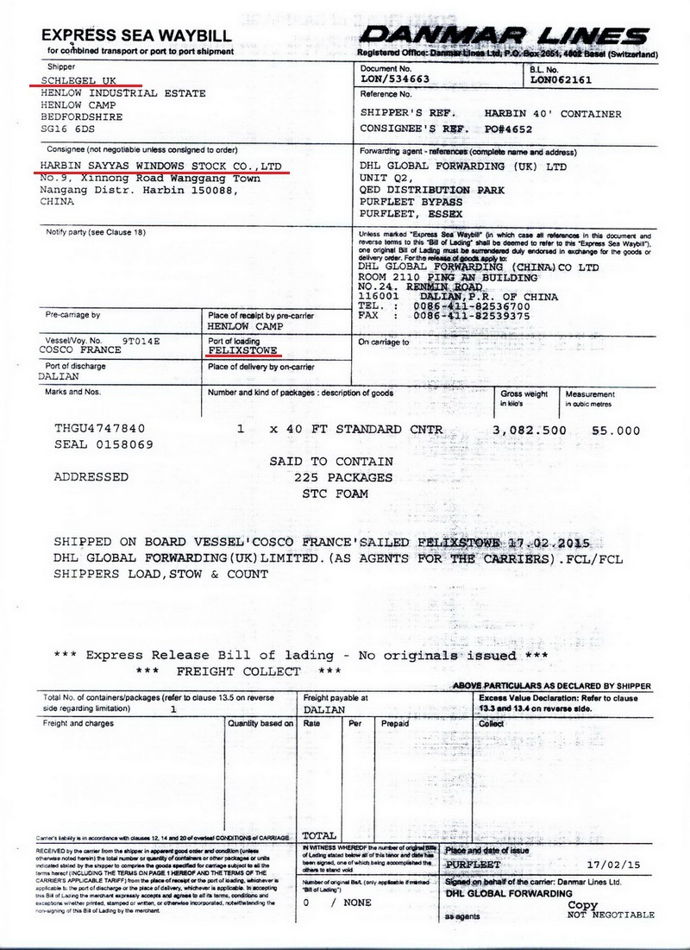
Sea Waybill
  Receipt for goods
  Evidence of the contract of carriage
  Not a document of title to the goods
  Main difference b/w sea waybill and B/L

Slide 34
Thank You

