Slide 1

Chapter 7
Export Pricing and Quotation

Slide 2
7.1 Cost
Contents
7.2 Expenses
7.3 Expected Profits

Slide 3

Cost
Expense
Price
Profit

Slide 4
7.1 Costs

Slide 6
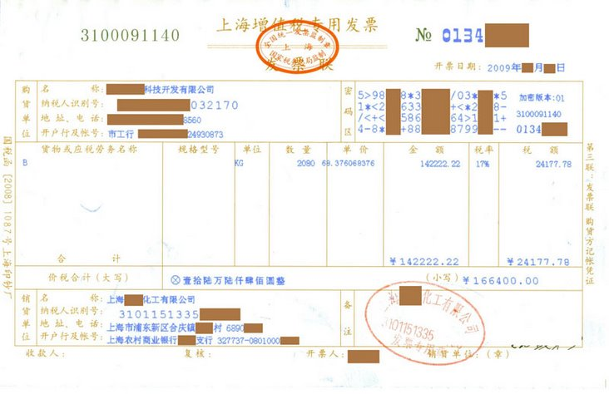

Slide 7
A exported Electric Bicycles that it purchased from suppliers at CNY 2,340 per set (with 17% VAT). The tax is rebated at the rate of 13%.
Please calculate the tax rebate and the real export cost for each set.

Slide 9
7.2 Expenses

Slide 11
Administrative expense
It might be a percentage of the puchase cost or recoded as it actually occurs.

Slide 12
Outsourcing fee
Bank fee
They are recoded as they actually occur.

Slide 14
If the export price is USD 100 per M/T CFRC5% London，how much will be paid per M/T as Commission?
C = 100 × 5% = USD 5

Slide 15
If the export price is USD 100 per M/T CFRC5% London，what is the net price?
N = 100 － 5 = USD 95

Slide 16
If the export price is USD 100 per M/T CFR London，please quote CFRC5% price with Seller’s income unchanged.
100
CFRC5%=
=USD 105.26
1－5%

Slide 17
If the export price is USD 100 per M/T CFRC2% London，please quote CFRC5% price with Seller’s income unchanged.
100×(1－2%)
CFRC5%=
=USD103.16
1－5%

Slide 18
Company A offered 200 pieces of goods at USD 65.00 per set CIFC5% San Francisco.
The goods would be purchased at CNY 500.00 per set (included 17% VAT). Tax would be rebated at 13% for export.
The exchage rate is CNY 6.20 for each US dollar.

Slide 19
  The expected fees for domestic transport, inspection, custom clearance, port affairs, public relations were CNY1,200, CNY200, CNY100, CNY800, and CNY1,000 respectively. Please calculate the domestic expense for each piece of goods.
  If the domestic expense was calculated at 5% of the purchase cost, please calculate the domestic expense for each piece of goods.

Slide 20
  The goods were purchased with loan from bank for 90 days at the annual rate of 9%. Please calculate the interest for each piece of goods.
  Bank charged fees at 0.5% of the involved amount. Please calculate the bank fee for each piece of goods.
  Please calculate the commission for each piece of goods.

Slide 21
Freight or Carriage
Insurance

Slide 23
7.3 Expected Profits

Slide 25

To persuade the buyer to accept our quotation
If we have to reduce our price:
    To bargain with our supplier to reduce the purchase cost.
    To lower the expenses.
    To give our new quotation with expected profit unchanged.
To adjust our expected profit and make a new offer
Bargaining

Slide 26
Thank You

