Slide 1

Chapter 8
Export Documentation

Slide 2
Contents
Overview of Contract Implementation
Complying Presentation under L/C
Export Documents

Slide 3
1. Overview of Contract Implementation 总览
Signing Sales Contract
Presentation/Negotiation
CIF
&
L/C
Preparing Goods
Documents Preparation
Booking Shipping Space
Loading Cargo
Commodity Inspection
Custom Clearance
Effecting Insurance
Certification

Slide 4
2. Complying Presentation under L/C
Complying Presentation
Presentation in accordance with
- Terms & conditions of the credit
- Applicable UCP provisions
- International standard banking practice (ISBP)
and no data conflicts among documents and the credit.
Notes:
Presentation of complying documents is vital to documentary credit.
Complying presentation means a presentation that is in accordance with the terms and conditions of the credit, the applicable provisions of these rules and international standard banking practice. The reference in this definition to international standard banking practice does not relate solely to the ICC publication of the same name.
Data in a document, need not be identical to, must not conflict with data in that document, other stipulated documents or the L/C.
单据中的数据，无需与该单据本身的数据，其他单据和信用
证的数据完全一致，但是不得矛盾。

Slide 5

Principle of International Trade Documentation under L/C
Document-Document Conformity
Document-Credit Conformity
Document-Goods Conformity
Credit-Contract Conformity
Bank
Exporter
Notes:
In documents other than the commercial invoice, the description of the goods, services or performance, may be in general terms not conflicting with their description in the credit.
除商业发票外，其他单据中的货物、服务或履约行为的描述，
可使用与信用证中的描述不矛盾的概括性用语。

Slide 6

Quality of Documents
  Accuracy
  Completeness
  Promptness
  Conciseness
  Cleanness

Slide 7
When an issuing bank determines that a presentation is complying, it must honour.
Issuing bank, in its sole judgment approach applicant for waiver of the discrepancies.
Banks may refuse to honour or negotiate discrepant documents.
Notice of refusal must be given to presenter no later than close of the fifth banking day following day of presentation.
Notes:
When an issuing bank determines that a presentation is complying, it must honour. 单证相符，必须承付。
Issuing bank, in its sole judgment approach applicant for waiver of the discrepancies.开证行确定交单不符时，可以自行决定联系申请人放弃不符点。
Nominated/Confirming/Issuing bank may refuse to honour or negotiate discrepant documents.交单不符时，可以拒绝承付或议付。

Slide 8
Important Dates for Presentation and Examination
  The expiry date of the credit
  UCP 600 Art. 6(d) – “A credit must state an expiry date
  for presentation.”
  Documents may be dated prior to issuance date of LC, but not later than the expiry date for presentation.
  Deadline for Presentation under L/C
  not later than 21 calendar days after the date of
  shipment and not later than the expiry date of the credit.
  Time for Examination
  Max. 5 banking days following the day of presentation

Slide 9
3. Export Documents
Major Documents under L/C and CIF Term
  Draft
  2. Commercial Invoice
  3. Packing List
  4. Bill of Lading
  5. Insurance Policy
  6. Inspection Certificate
  7. Certificate of Origin
Notes:
Bill of exchange: A signed, written order by one business that instructs another business to pay a third business a specific amount. Also called a draft. datek.smartmoney.com/glossary/index.cfm
A written, unconditional order by one party (the drawer) to another (the drawee) to pay a certain sum, either immediately (a sight bill) or on a fixed date (a term bill), for payment of goods and/or services received. The drawee accepts the bill by signing it, thus converting it into a post-dated check and a binding contract.
Read more: http://www.businessdictionary.com/definition/bill-of-exchange-BOE.html

Slide 10
Other Documents
  8. Beneficiary’s Certificate
  9. Shipping Advice
  10. Export Customs Declaration Form
Notes:
Bill of exchange: A signed, written order by one business that instructs another business to pay a third business a specific amount. Also called a draft. datek.smartmoney.com/glossary/index.cfm
A written, unconditional order by one party (the drawer) to another (the drawee) to pay a certain sum, either immediately (a sight bill) or on a fixed date (a term bill), for payment of goods and/or services received. The drawee accepts the bill by signing it, thus converting it into a post-dated check and a binding contract.
Read more: http://www.businessdictionary.com/definition/bill-of-exchange-BOE.html

Slide 11
1. Draft
Draft = Bill of Exchange
A written, unconditional order issued by one party (the drawer) to another (the drawee) to pay a certain sum to the payee, either immediately (a sight bill) or on a fixed date (a term bill), for payment of goods and/or services received.
Draft drawn under L/C should be, as mentioned above, in strict compliance with the credit terms.
Notes:
Bill of exchange: A signed, written order by one business that instructs another business to pay a third business a specific amount. Also called a draft. datek.smartmoney.com/glossary/index.cfm
A written, unconditional order by one party (the drawer) to another (the drawee) to pay a certain sum, either immediately (a sight bill) or on a fixed date (a term bill), for payment of goods and/or services received. The drawee accepts the bill by signing it, thus converting it into a post-dated check and a binding contract.
Read more: http://www.businessdictionary.com/definition/bill-of-exchange-BOE.html

Slide 12

Parties of Draft in L/C Context
Drawer
A draft drawn on
Drawee
Seller (exporter)
Beneficiary of L/C
Payer
Issuing bank of L/C
Purchases draft and pay
Reimburses
Presents draft and documents
Presents draft and documents
Payee
Negotiating Bank

Slide 13
Specify Payee
Demonstrative order
  Pay to the order of Bank of China (negotiating bank)
Restrictive order
Pay to x x x only or Pay to x x x only not transferable
x x x = company or person
Payable to bearer
Pay to bearer/holder
Not acceptable in China

Slide 14
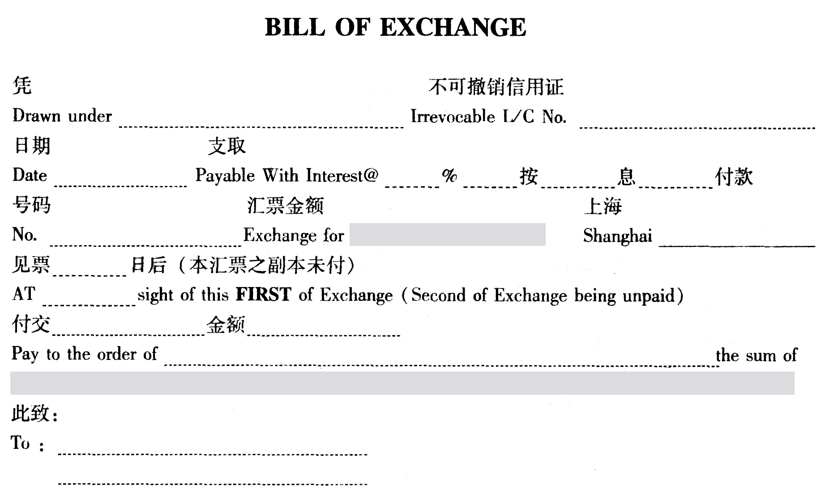
Issuing bank
Number of L/C
Interest
Date of L/C
No. of draft
Amount in figures
Place/date of draft
Tenor
Name of payee (negotiating bank)
Amount in words
Name of drawee
Name of drawer
(signature)

Slide 15
SAMPLE
STANDARD CHARTERED FIRST BANK LTD. SEOUL, KOREA
M1871008NU00066
2010-08-13
YD2010080012
USD85900.00
2010-09-30
************
BANK OF CHINA, SHANGHAI BRANCH
SAY U.S.DOLLARS EIGHTY FIVE THOUSAND NINE HUNDRED ONLY.
SHANGHAI SEVEN SEAS TRADING COMPANY 刘凯
STANDARD CHARTERED FIRST BANK LTD.
SEOUL, KOREA
Notes:
Bill of exchange: A signed, written order by one business that instructs another business to pay a third business a specific amount. Also called a draft. datek.smartmoney.com/glossary/index.cfm
A written, unconditional order by one party (the drawer) to another (the drawee) to pay a certain sum, either immediately (a sight bill) or on a fixed date (a term bill), for payment of goods and/or services received. The drawee accepts the bill by signing it, thus converting it into a post-dated check and a binding contract.
Read more: http://www.businessdictionary.com/definition/bill-of-exchange-BOE.html
A Bill of Exchange is an instrument in writing containing an unconditional order, signed by the maker, directing a certain person to pay a certain sum of money only to, or to the order of a certain person or to the bearer of the instrument.

Slide 16
2. Commercial Invoice
An invoice provided by the seller of goods, stating the identities of the buying and selling parties, what is being sold, what total amount of money is to be exchanged, when the transaction takes place, and how payment should be done.
Initial document issued by the beneficiary of L/C
The earliest document among all other documents
As the basis for other export documents
The date of commercial invoice can be earlier than the issuing date of L/C, but should not be later than the expiry date of L/C.

Slide 17
UCP 600 Article 18 on C/I
The issuer of C/I should be the beneficiary of L/C.
The C/I must be made out in the name of the applicant.
Currency of the commercial invoice should be the same as the credit.
No signature required.

Slide 18
Usually the amount of C/I should not exceed the amount permitted by the credit.
Invoice amount in excess of L/C – may be accepted by banks, but must not be honored or negotiated in excess of L/C amount.
Description of goods, services or performance must correspond with L/C description.

Slide 19
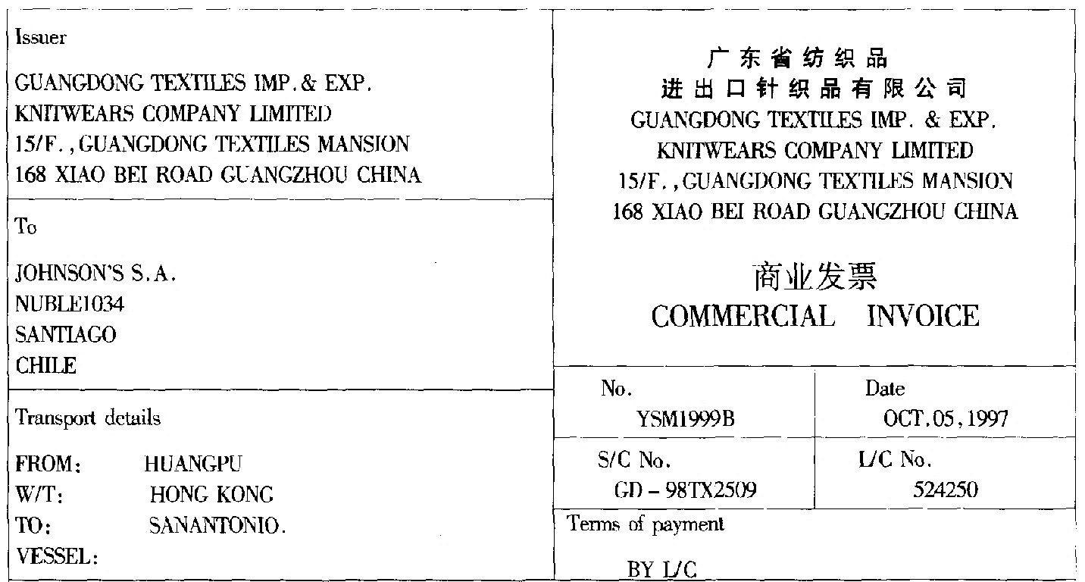
Sample Commercial Invoice
Notes:
Name and address of the seller
Name and address of the buyer
Means of transport and route
Invoice number
Invoice date
Contract number
L/C number
Terms of payment

Slide 20
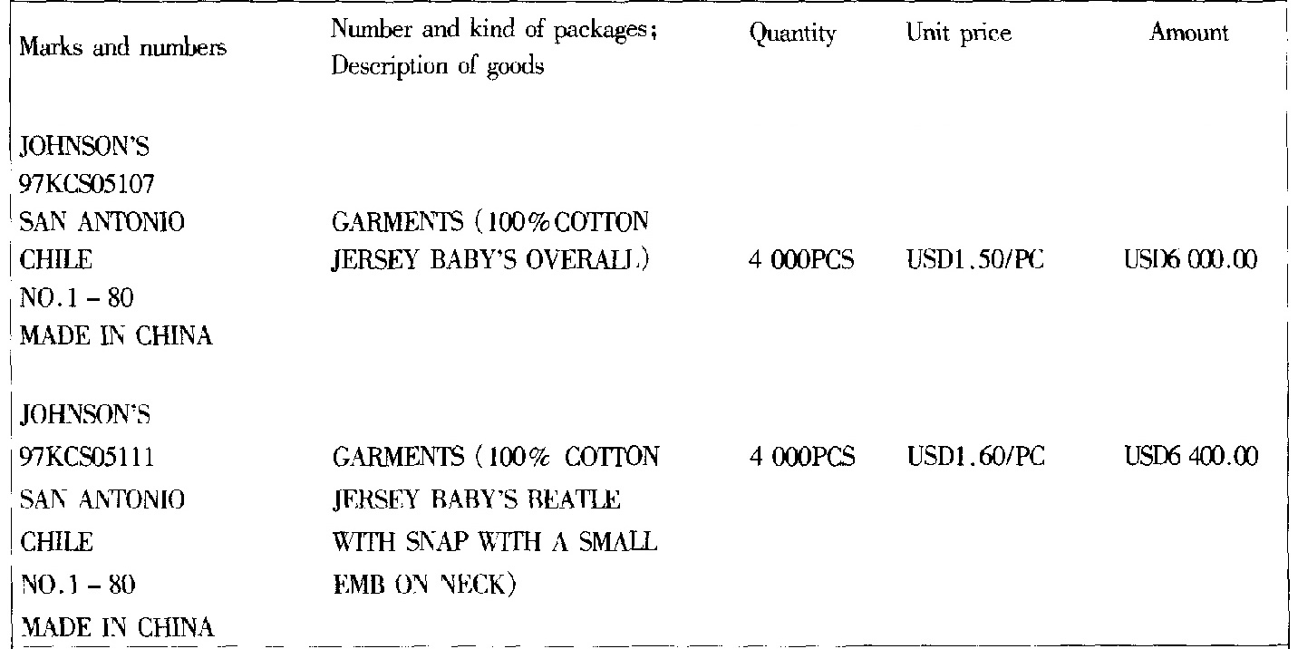
Sample Commercial Invoice (Cont.)
Notes:
Marks and numbers
Number, packing and description of goods
Quantity
Unit price
Amount

Slide 21
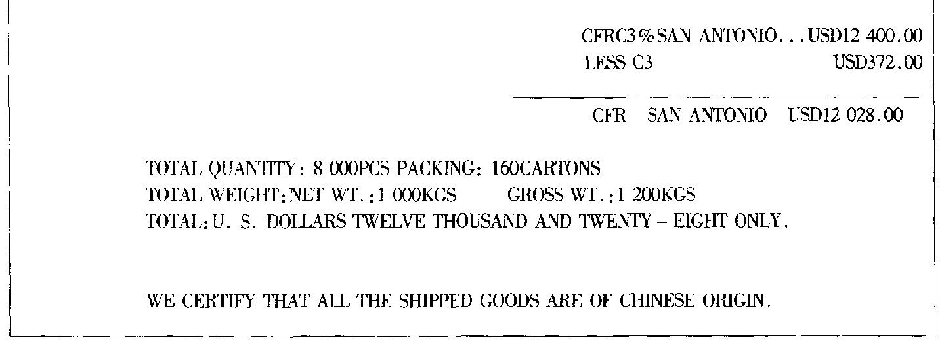
Notes:
Total value (commission deducted)
Total quantity, total number of cartons, Total weight, Total value in USD$
Statement about origin of goods

Slide 22
Pro-forma Invoice (P/I)
  A preliminary invoice
  Purposes of the P/I
Customs Invoice
  Required by Customs of US, Canada, Australia, Mexico, …
  Purposes of the customs invoice
Consular Invoice
  Issued by the Consul of the importing country in the exporting country
  Purposes - similar to that of customs invoice
Notes:
A pro-forma invoice is a preliminary bill of sale sent to buyers in advance of a shipment or delivery of goods. Typically, it gives a description of the purchased items and notes the cost along with other important information, such as shipping weight and transport charges. Pro-forma invoices are often used for customs purposes on imports.
A pro-forma invoice differs from a simple price quotation in that it is usually considered a binding agreement, despite the fact that, like a price quote, the terms of sale are subject to change. A wide variety of businesses in virtually all industries use pro-forma invoices.
Most pro-forma invoices provide the buyer with a precise sale price. It includes any commissions or fees, such as applicable taxes or shipping costs. Though the pro-forma invoice may be subject to change, it serves as a good faith estimate to avoid exposing the buyer to any unexpected charges once the transaction has fully completed.
A pro-forma invoice may be sent prior to the shipment of any agreed-upon deliverables, or along with the shipped items. While it does contain exact details regarding the costs associated with the sale, it does not serve as an official invoice upon which a payment must be made.
Read more: Pro-Forma Invoice http://www.investopedia.com/terms/p/pro-forma-invoice.asp#ixzz4nZLtav8n
Follow us: Investopedia on Facebook
An abridged or estimated invoice sent by a seller to a buyer in advance of a shipment or delivery of goods. It notes the kind and quantity of goods, their value, and other important information such as weight and transportation charges. Pro forma invoices are commonly used as preliminary invoices with a quotation, or for customs purposes in importation. They differ from a normal invoice in not being a demand or request for payment.
Read more: http://www.businessdictionary.com/definition/pro-forma-invoice.html
Customs Invoice
Extended form of commercial invoice required by customs (often in a specified format) in which the exporter states the description, quantity and selling price, freight, insurance, and packing costs, terms of delivery and payment, weight and/or volume of the goods for the purpose of determining customs import value at the port of destination.
Read more: http://www.businessdictionary.com/definition/customs-invoice.html
Customs invoices are a critical component of the export paperwork. Invoices indicate the buyer and seller of the goods, a description of the items, their value, and the terms or proposed terms of the sale. Many governments use invoices for calculating and assessing customs duties and taxes. Governments that use invoices to control imports will often specify the invoice’s form, content, number of copies, language(s) to be used, and other characteristics.
DEFINITION of 'Consular Invoice'
A document certifying a shipment of goods and shows information such as the consignor, consignee and value of the shipment. A consular invoice can be obtained through a consular representative of the country you're shipping to. The consular invoice is required by some countries to facilitate customs and collection of taxes.
BREAKING DOWN 'Consular Invoice'
A consular invoice also has a copy of the commercial invoice in the language of the country, giving full details of the merchandise shipped. In general, the purpose is to provide the foreign customs authority with a complete, detailed description of the goods so that the correct import duty can be levied.
Read more: Consular Invoice http://www.investopedia.com/terms/c/consular-invoice.asp#ixzz4nZPmdi14
Follow us: Investopedia on Facebook

Slide 23
3. Packing List/ Weight List/ Measurement List
An itemized list of articles giving the quantity, packing, description, and weight and volume of the contents.
Supplement to commercial invoice.
For the purposes of
  Buyer’s reference regarding packing and quantity of the goods
  Custom clearance and inspection at the destination

Slide 24
The name of the list does not need to be exactly the same name of the list as required in L/C.
It usually does not include unit price and total price.
Packing list and the invoice are usually issued at the same time.
Neutral packing list: no name of the seller on the list
Weight list and measurement list: similar to packing list

Slide 25
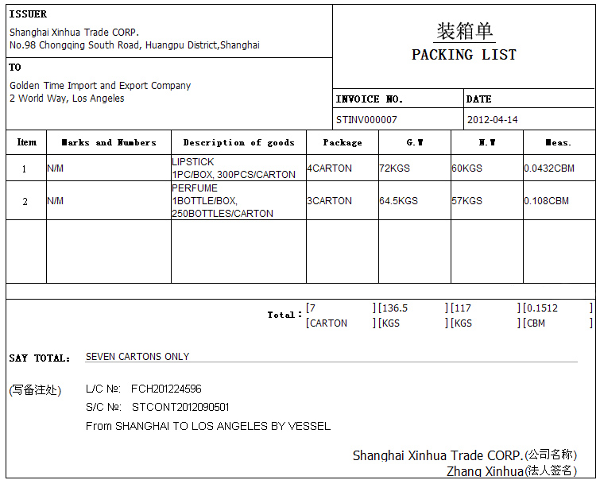
Notes:
Name and address of the seller
Name and address of the buyer
Invoice no.
Date of list
Marks and numbers
Description
Packing
Weight and volume
Total amount
L/C, contract no. transport if required
Signature

Slide 26
4. Bill of Lading
A document issued by a carrier, or its agent, to the shipper as a contract of carriage of goods.
A bank will only accept a clean on-board bill of lading for L/C negotiation.
A clean transport document is one bearing no clause or notation expressly declaring a defective condition of the goods or their packaging.
Notes:
As a result, presentation of an unclean bill of lading would create a discrepancy which will be named as unclean bill of lading discrepancy.

Slide 27
A presentation including one or more original transport documents must be made by or on behalf of the beneficiary not later than 21 calendar days after the date of shipment. But in any event not later than the expiry date of the credit.

Slide 28
B/L must indicate the name of the carrier and be signed by the carrier or the master or their named agents.
The date of issuance of B/L will be deemed to be the date of shipment unless B/L contains an on board notation indicating the date of shipment, in which case the date stated in the on board notation will be deemed to be the date of shipment.

Slide 29
Must indicate shipment from the port of loading to the port of discharge stated in the credit.
If issued in more than one original, all originals are required.
Usually carrier will provide two sets of original B/L. May issue three sets.

Slide 30
UCP 600 on transshipment
  Transhipment means unloading from one vessel and reloading to another vessel during the carriage from the port of loading to the port of discharge stated in the credit.
  B/L may indicate that the goods will or may be transhipped provided that the entire carriage is covered by one and the same B/L.

Slide 31
  B/L indicating that transhipment will or may take place is acceptable, even if the credit prohibits transhipment, if the goods have been shipped in a container, trailer or LASH barge as evidenced by B/L.
  Clauses in a B/L stating that the carrier reserves the right to tranship will be disregarded.

Slide 32
Sample bill of lading and elements of the document are presented in the “Shipping documents” part of Chapter 5 – International Cargo Transport.

Slide 33
5. Insurance Documents
Insurance Policy - A document detailing the type and amount of insurance coverage.
Insurance Certificate - A simplified version of an insurance policy.
Open Policy/Open Cover - A type of insurance policy in which the insurer agrees to provide coverage for all cargo shipped during the policy period.
Cover notes not acceptable by the bank.
Notes:
Formal contract-document issued by an insurance company to an insured. It (1) puts an indemnity cover into effect, (2) serves as a legal evidence of the insurance agreement, (3) sets out the exact terms on which the indemnity cover has been provided, and (4) states associated information such as the (a) specific risks and perils covered, (b) duration of coverage, (c) amount of premium, (d) mode of premium payment, and (e) deductibles, if any.
Read more: http://www.businessdictionary.com/definition/insurance-policy.html
a continuous policy of marine insurance that is terminable by either party after notice, covers specific shipments automatically, and has the premiums determined by the values reported.
Open policy provides blanket cover against loss or damage to all goods transported by a specific carrier, or by a specific shipper, during a stated period. Under its terms, the insured is required to periodically provide the insurer with the description, quantity, and value of goods shipped during that period.
A type of insurance policy intended to cover and indefinite number of future individual requirement. The insurance contract remains in force until canceled. Under the open policy, individual successive shipments are periodically reported or declared to the insurer and automatically covered on or after the inception date. Open policies can provide efficiency and savings for all parties concerned, especially when the insured conducts a significant volume of highly similar transactions. Some letter of credit transactions require evidence of an individual policy covering the specified shipment. In such cases it has become the practice to use an insurance certificate.

Slide 34
Issued and signed by insurance company, underwriter or their agents or their proxies. Signed by agent or proxy indicated as being for or on behalf of insurance company or underwriter.
All originals must be presented, if the document indicates that more than one original has been issued.

Slide 35
Issued no later than shipment date, or it appears from the document that cover is effective from a date no later than shipment date.
Insurance Policy
Bill of Lading
Effective Date
1 SEP 2015
Shipped On Board
1 SEP 2015
Issued on 8 SEP 2015
Issued on 1 SEP 2015

Slide 36
In practice, the effective date of insurance should not be later than the date when the goods leaving exporter’s warehouse in order to be avail of extended protection of “warehouse-to-warehouse” clause.
Risk covered at least:
… as stated in L/C.
place of taking in charge or shipment
place of discharge or final destination

Slide 37
Amount of insurance coverage
  The currency should be the same as that in the credit.
  Insurance coverage expressed in the L/C as percentage of goods/invoice value (e.g. 110% of CIF value) is deemed to be minimum coverage required.
Invoice:
Total CIF value US$100,000
L/C: Insurance required for
110% of invoice value in US$
Insurance Policy:
Insured Amount US$120,000
120%
Min. coverage required
Acceptable

Slide 38
PICC does not accept insured amount > 130% of invoice value.
If CIF or CIP value cannot be determined from documents –take the greater of the following:
➔ Amount for which honour or negotiation is requested
➔ Gross invoice value of the goods

Slide 39
Covered risks
  L/C should state type of insurance required and additional risks to be covered.
  If L/C uses imprecise terms such as “usual risks” or “customary risks”, bank will accept insurance document without regard to any risks not covered.

Slide 40
  If L/C requires insurance against “all risks”, bank will accept insurance document containing any “all risks” notation or clause, without regard to any risks stated to be excluded.

Slide 41
  An insurance document may contain reference to any exclusion clause.
  An insurance document may indicate that the cover is subject to a franchise or excess (deductible).
Sample insurance policy and elements of the document are presented in the “Insurance practices in international trade” part of Chapter 6 – International Marine Cargo Insurance.

Slide 42
6. Inspection Certificates
Written documents issued by the commodity inspection bodies certifying that the goods are in conformity with the specifications stated on the sales contract.
Scope of inspection – quality, quantity, weight, origin, sanitary etc.
Contents of an inspection certificate must be in conformity with the L/C.

Slide 43

Chinese Inspection Authority
GACC and its regional Entry-Exit Inspection and
Quarantine Bureaus
for statutory inspection of certain products in the
List
Independent Inspection Companies
China Certification & Inspection Group (CCIC)
SGS - Switzerland
Bureau Veritas - France
TÜV SÜD and TÜV Rheinland - Germany
Intertek - UK

Slide 44
Apply for inspection
at least 10 days before the date of shipment
Issuing date of inspection certificate should be no later than the date of shipment as shown on B/L
can be the same day or earlier
Inspection certificate issued by the inspection authority is valid for
  general products - 60 days
  perishable goods - 14 days

Slide 45
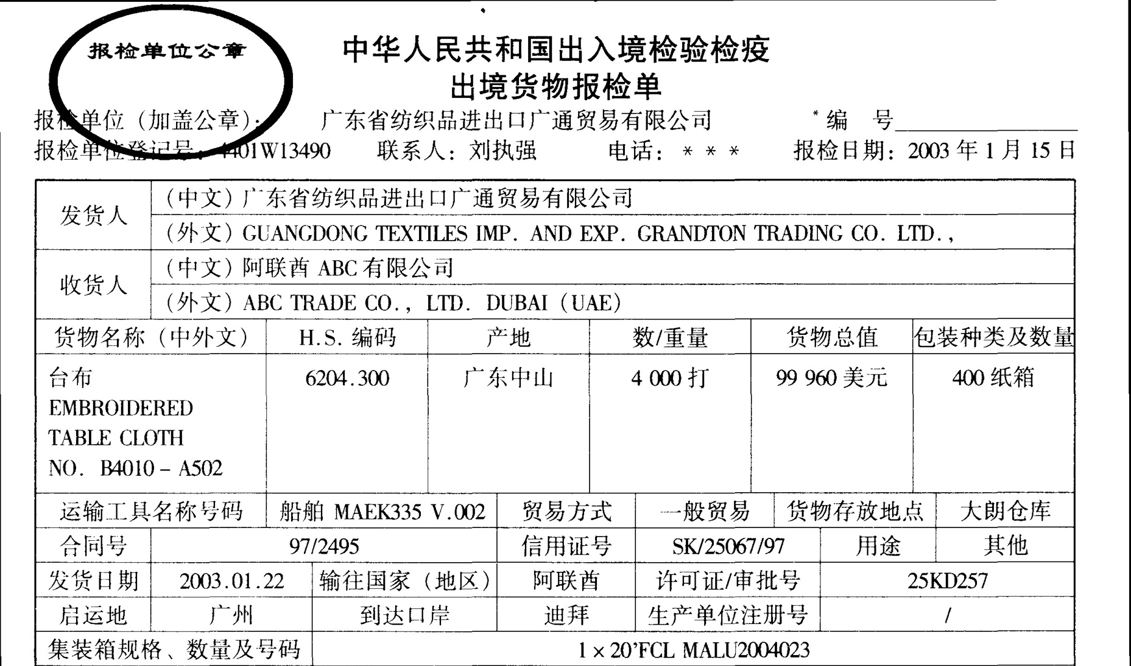

Slide 46
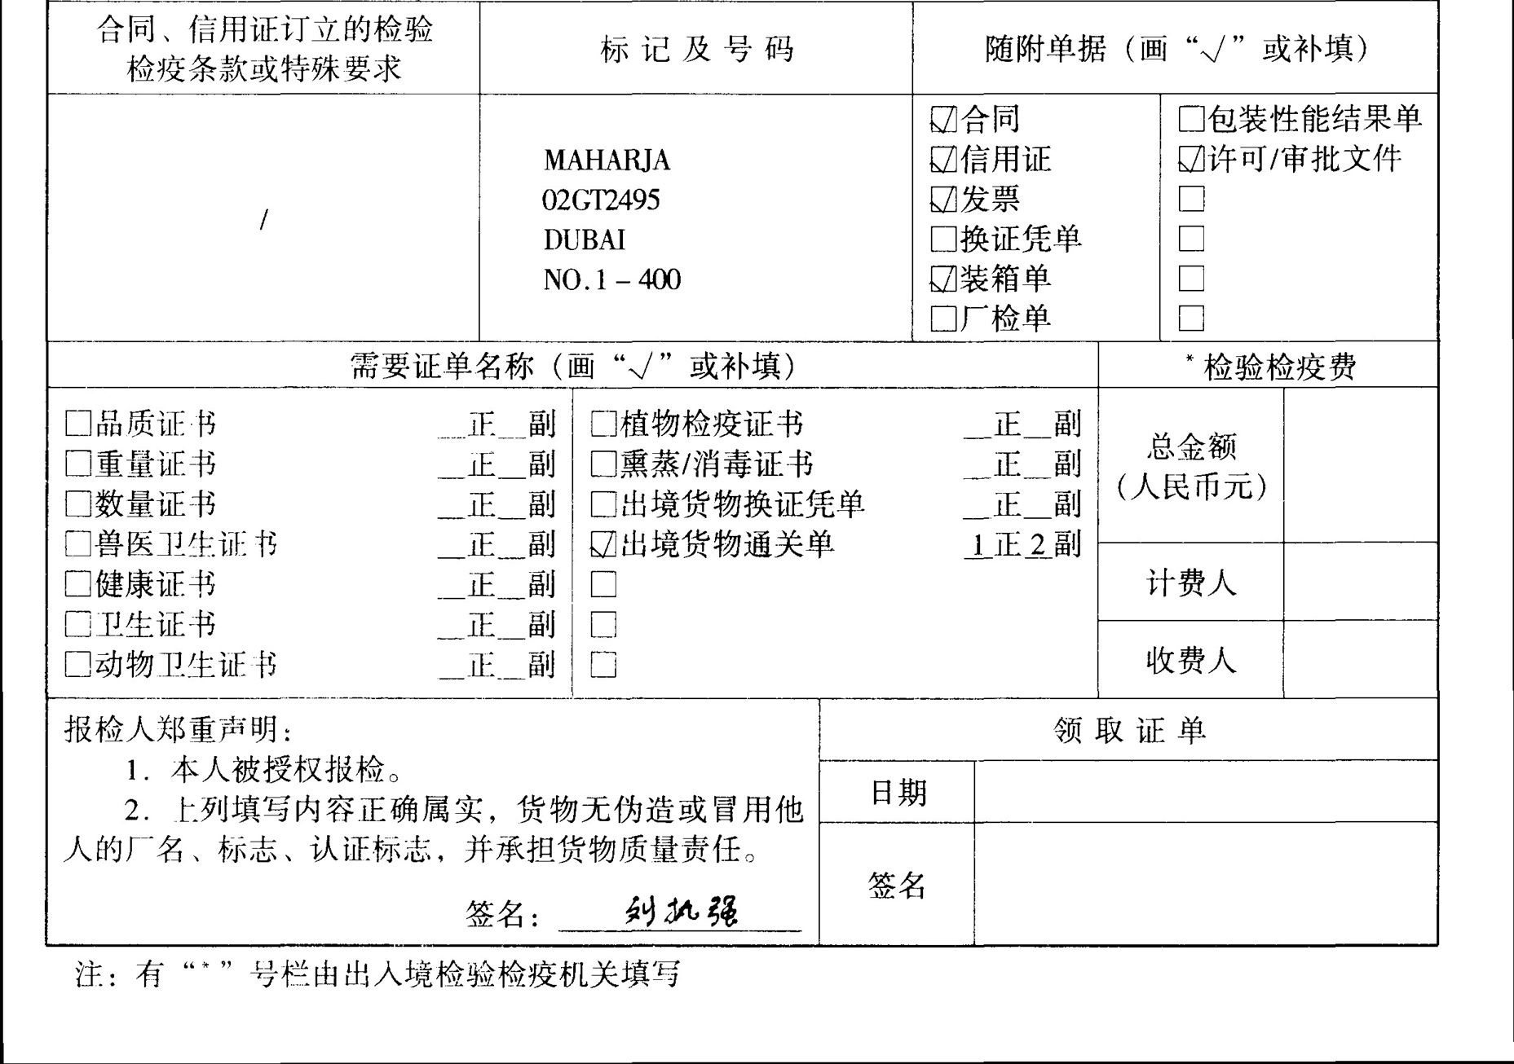

Slide 47
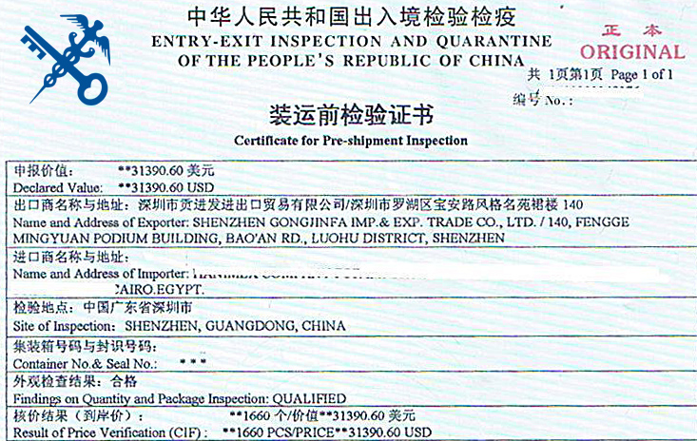

Slide 48
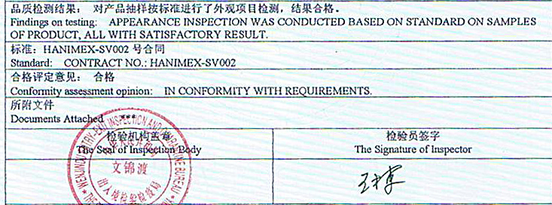

Slide 49
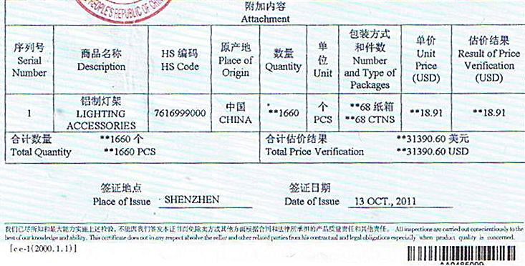

Slide 50
7. Certificate of Origin
Certificate of Origin (C/O) “Ordinary C/O”
  To certify that the goods in a particular export shipment are wholly obtained, produced, manufactured or processed in a particular country.
  For importing country custom
    whether the goods may be legally imported
    determine the duty
    apply quota
    statistical purposes
Notes:
哪家机构出具取决于信用证要求。无要求的，一般由商检局出具，但是银行应该接受两个机构出具的证书。
Determining the origin of a product is important because origin is a key information for applying tariffs, embargo and other trade policies.
Virtually every country in the world considers the origin of imported goods when determining the duty that will be applied or, in some cases, whether the goods may be legally imported at all.
There are two types of COs that chambers can issue:
Non-Preferential COs, which certify that the goods’ country of origin does not qualify for any preferential treatment. These are the main type of COs that chambers issue and are also known as “ordinary COs.”
Preferential COs, which certify that goods are subject to reduced tariffs or exemptions when they are exported to countries extending these privileges. COs may be needed to comply with Letters of Credit, foreign Customs requirements or a buyer’s request.

Slide 51
  In China two institutes can issue C/O
  - China Customs
  - CCPIT
  L/C may specify which institute to issue a C/O. If not specified in L/C, usually choose China Customs and the bank should accept C/O issued by any of the two institutes.
  Time to apply for C/O
  no later than three(3) days before shipment

Slide 52
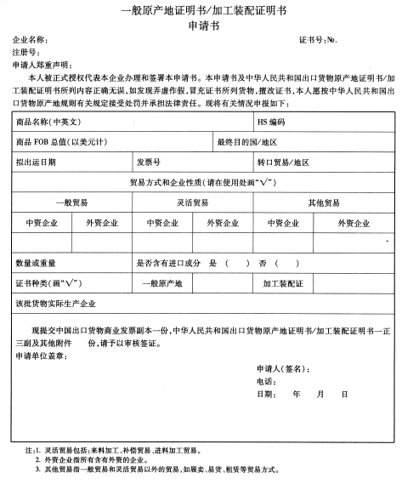
Documents required for application for the certificate of origin:
一般原产地证书/加工装配证明书申请书
Certificate of Origin (4 copies filled by the exporter)
Commercial invoice
Other required documents

Slide 53
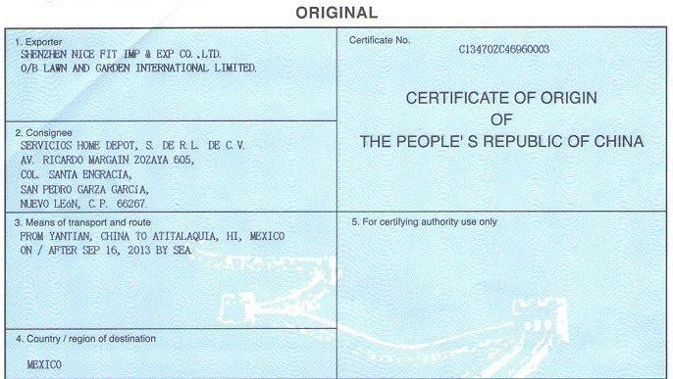

Slide 54
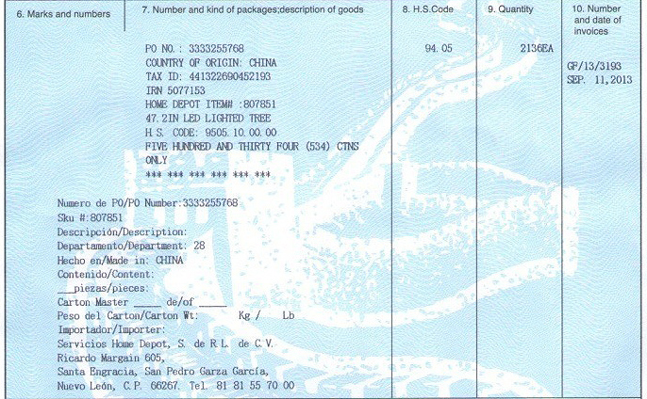

Slide 55


Slide 56
Generalized System of Preferences Certificate of Origin Form A (GSP C/O Form A)
  Generalized System of Preferences (GSP) is a preferential tariff system extended by developed countries (also known as donor countries) to developing countries (also known as beneficiary countries). It involves reduced MFN Tariffs or duty-free entry of eligible products exported by beneficiary countries to the markets of donor countries.
  MFN: most favored nation

Slide 57
Donor countries for China
  39 countries as of 2017
EU member states | Liechtenstein
Australia | Russia
New Zealand | Ukraine
Japan | Belarus
Canada | Kazakhstan
Switzerland | Turkey
Norway

Slide 58
In China, China Customs is in charge of issuing GSP C/O Form A
Issued by regional Entry-Exit Inspection and Quarantine
Bureau
Language of the form is English or French (if required).
It is a combined declaration (by exporter) and certificate (by authority).
Should reach the buyer before the shipment arrives at the destination for Customs inspection.

Slide 59
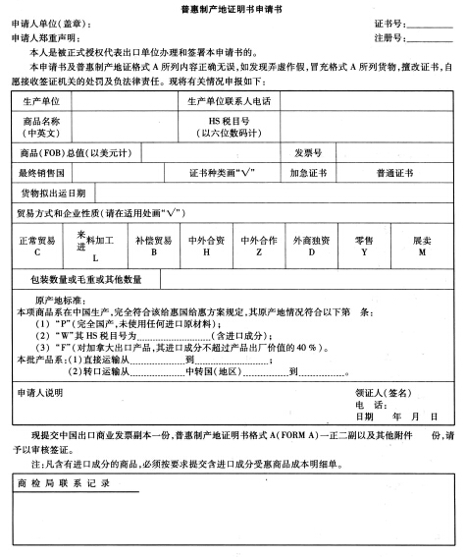
Documents required for application for GSP C/O Form A:
普惠制产地证明书申请书
GSP C/O Form A (3 copies filled by the exporter)
Commercial invoice
《含进口成分商品成本明细单》if containing imported materials or components
Other required documents

Slide 60
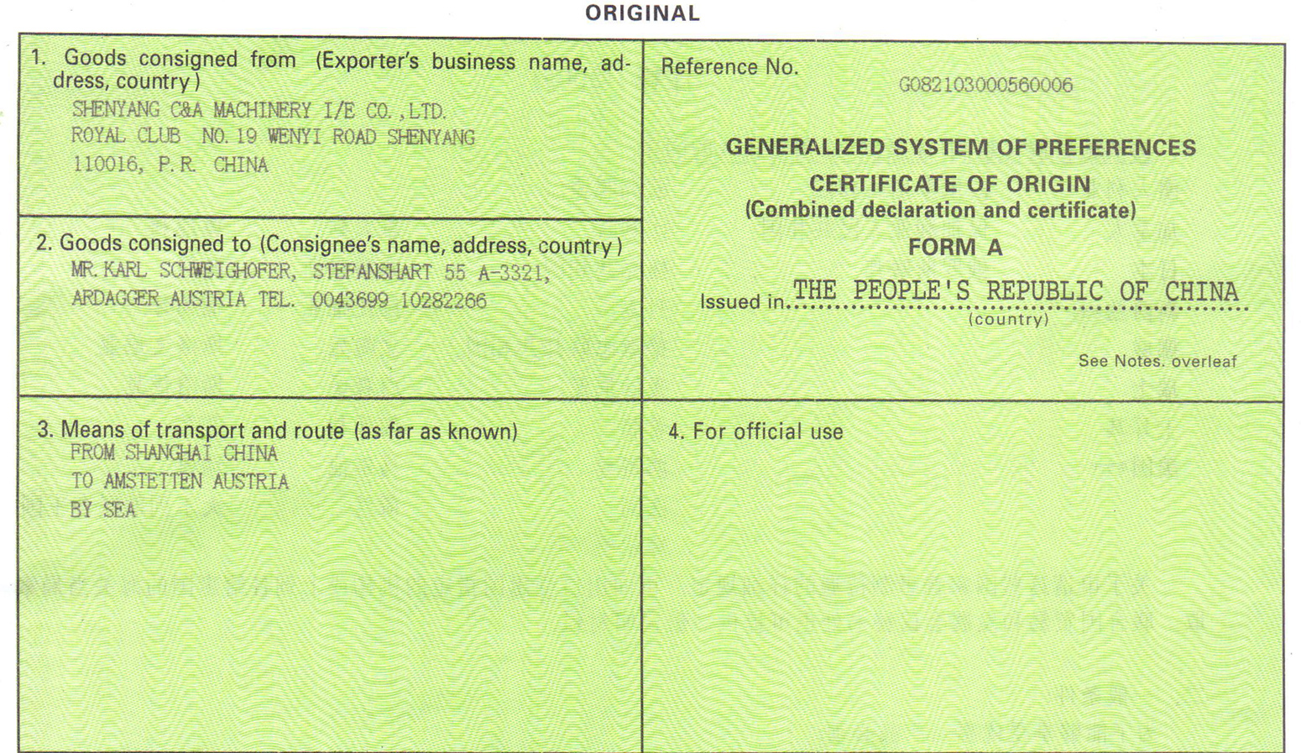

Slide 61
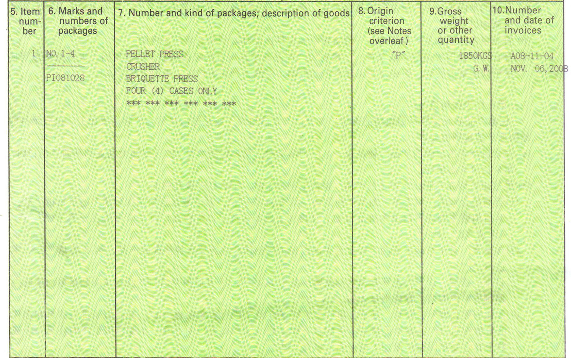

Slide 62
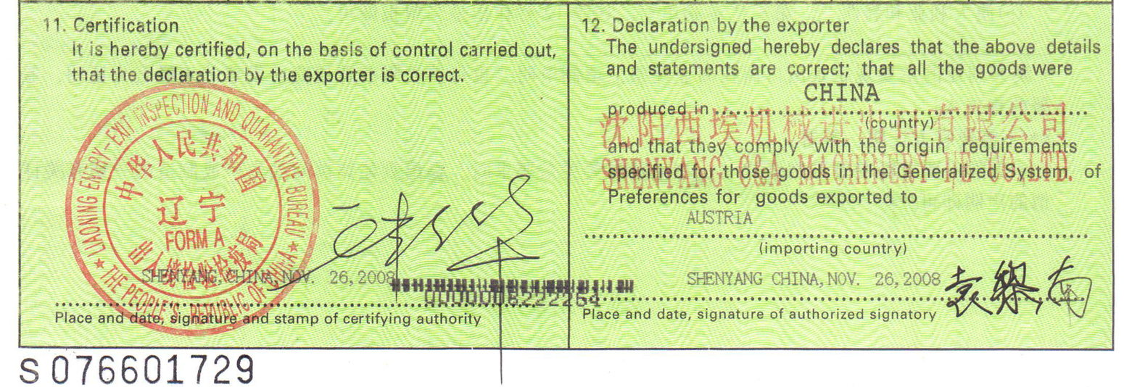

Slide 63
8. Beneficiary’s Certificate
A document that provides beneficiary admittance that the action or the event stipulated in the credit has been fulfilled.
Types
  BC for Dispatch of Documents
  BC for Dispatch of Shipment Sample
  BC for Packing and Label
  BC for Fulfillment
Conformity with the Credit
Date of issuing not contradict with the requirement of credit
Must be signed by the beneficiary

Slide 64
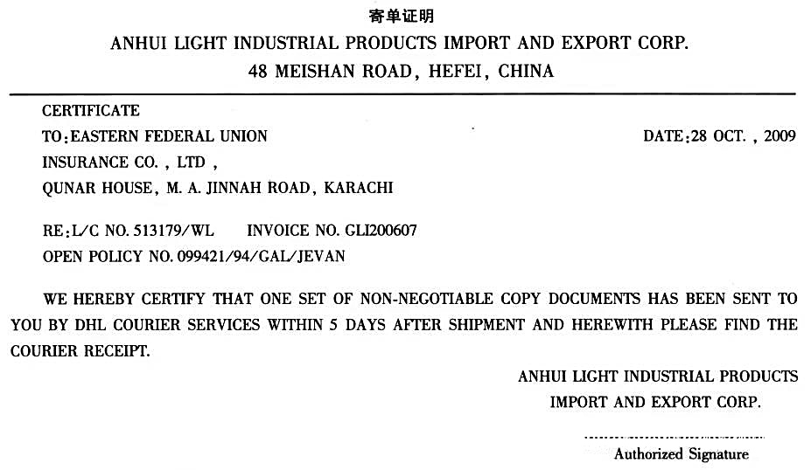

Slide 65
9. Shipping Advice
A notice sent to the buyer advising that shipment has gone forward and contains details of packing, routing and carrier, etc.
Under the FOB, CFR, FCA or CPT term
For the importer to arrange cargo insurance
Under CIF and CIP term
For the importer to track the shipment and to initiate import
custom operations
A shipment advice should be created and dispatched within 3 days after the date of shipment.
Notes:
The main function of the shipment advice is to allow importers to arrange transport insurance in a timely manner. Especially this document is vital importer in which situations importers have to arrange the transport insurance, such as FCA, FOB, CFR, FAS, CPT and EXW deliveries.

Slide 66
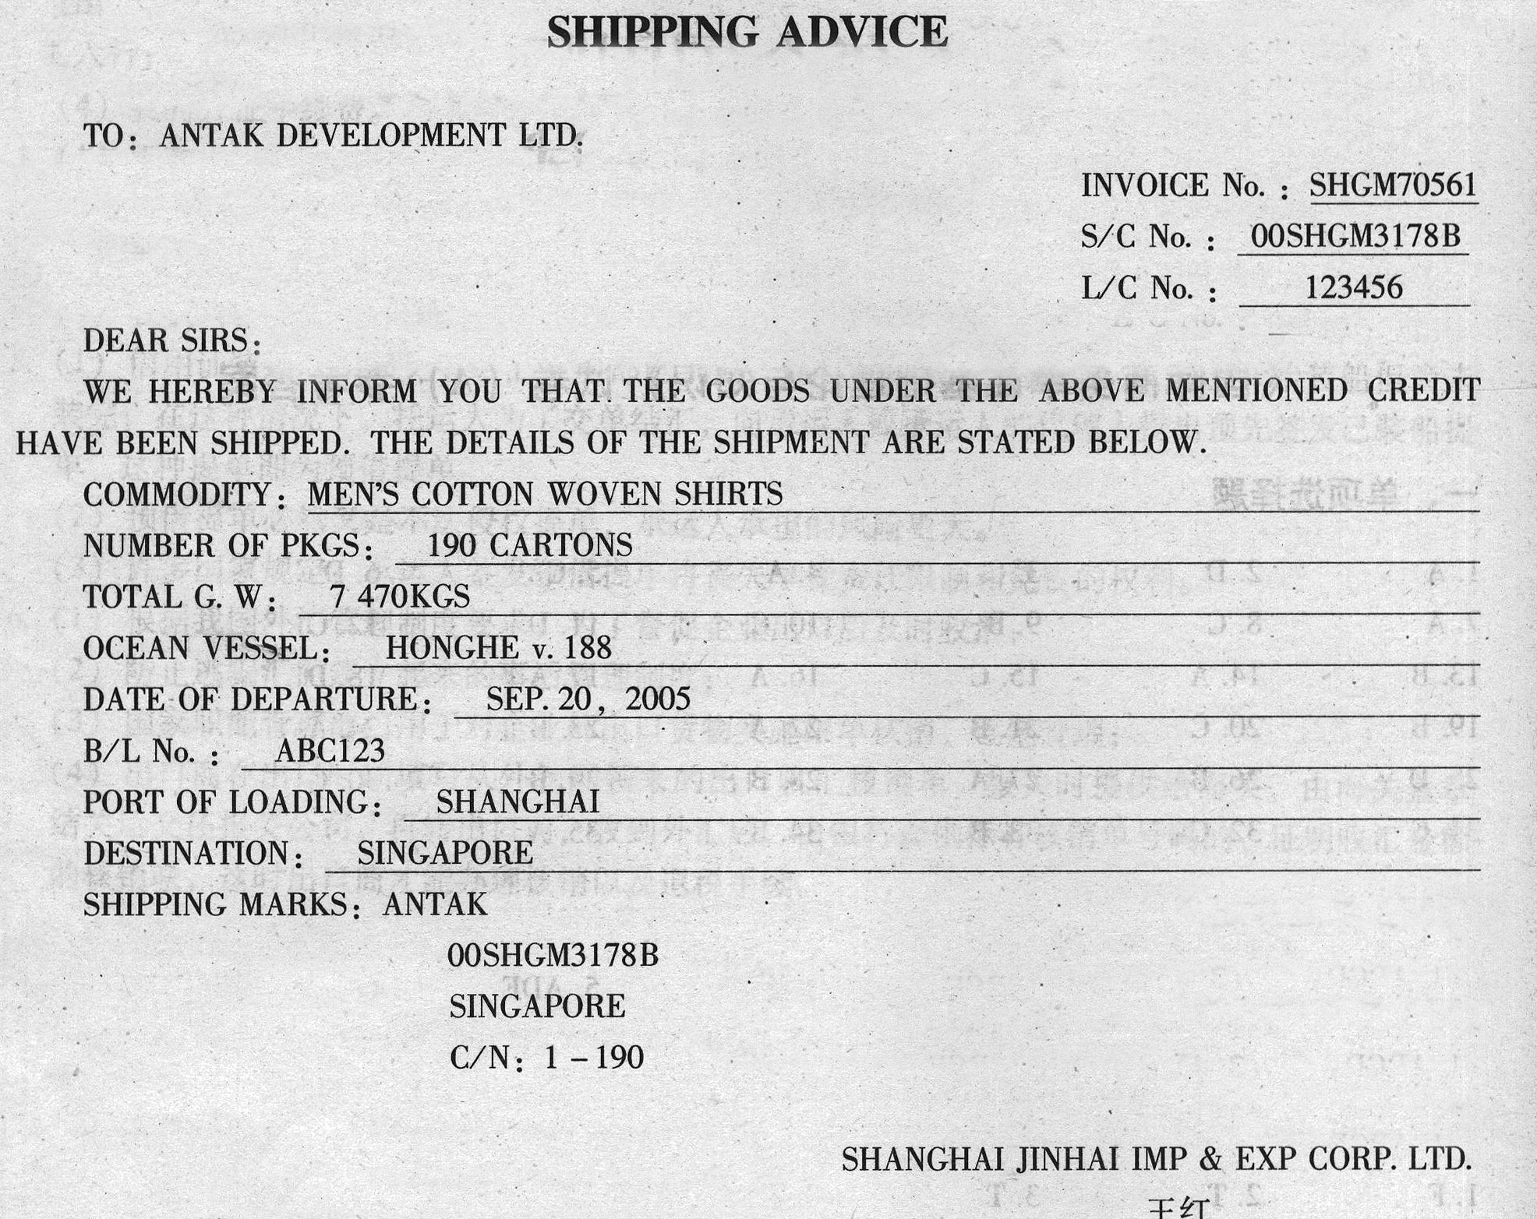
Notes:
The name of the document must be the same as specified in the L/C.

Slide 67
10. Export Customs Declaration Form
A declaration submitted by the exporter or his agent to China Customs for obtaining customs clearance for export commodities, detailing
- identity of the exporter and consignee
- description of the goods
- means of transportation
- place of export (port)
- mode of trading
- trade term
- applicable tax rate
- HS code, etc.

Slide 68

Customs Clearance Procedure
Application
Inspection
Levying Tax
Clearance
The exporter or his agent must submit the declaration form at least 24 hours prior to the time of commencing loading operation.
Document-Credit Conformity
Document-Goods Conformity

Slide 69
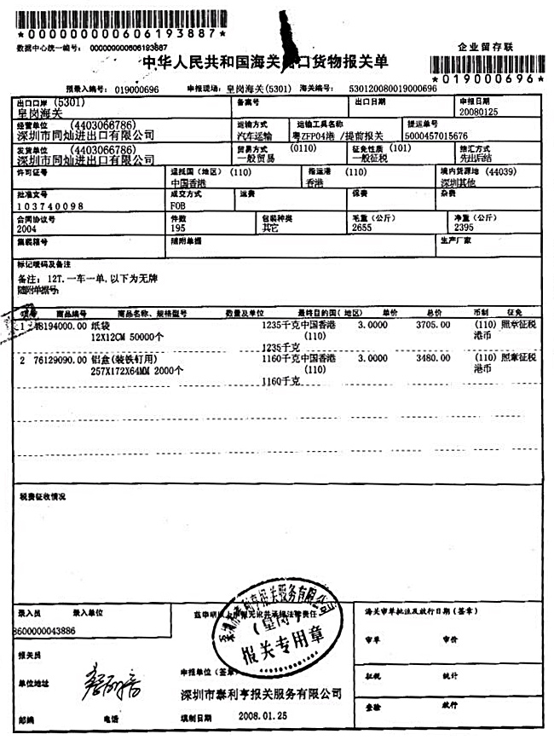
Sample export customs declaration form
Accompanying documents
  Commercial invoice
  Bill of lading
  Export permit (if required)
  Packing list
  Contract
  Inspection certificate
  Certificate of origin
  …

Slide 70
Thank You

