Slide 1
Chapter 14
Remittance and Collection

Slide 2
14.1 Remittance
Contents
14.2 Collection

Slide 3
14.1 Remittance

Slide 4

What is remittance?
Remittance refers to transfer of funds from the payer to the payee among different countries through banks.

Slide 5

01
Cable
Telex
M/T
02
T/T
Mail Transfer
Lower speed and charges
Telegraphic Transfer
Higher speed and charges

Slide 6
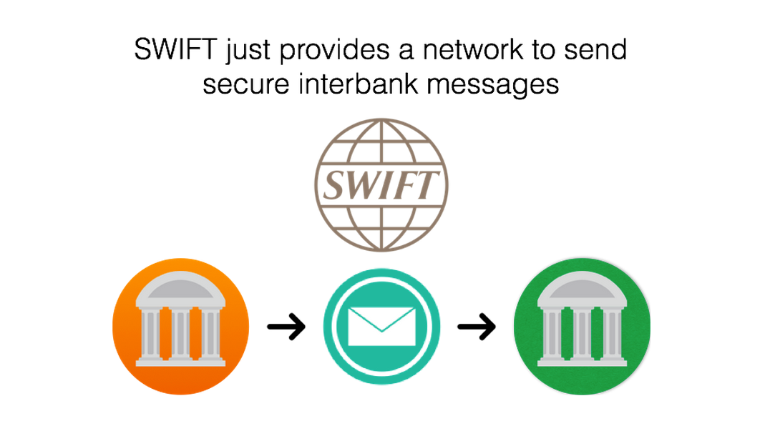
Society for Worldwide Interbank Financial Telecommunication

Slide 7



T/T
Importer
Exporter
Payer
Importer's Bank
Exporter's Bank
Payee

Slide 8
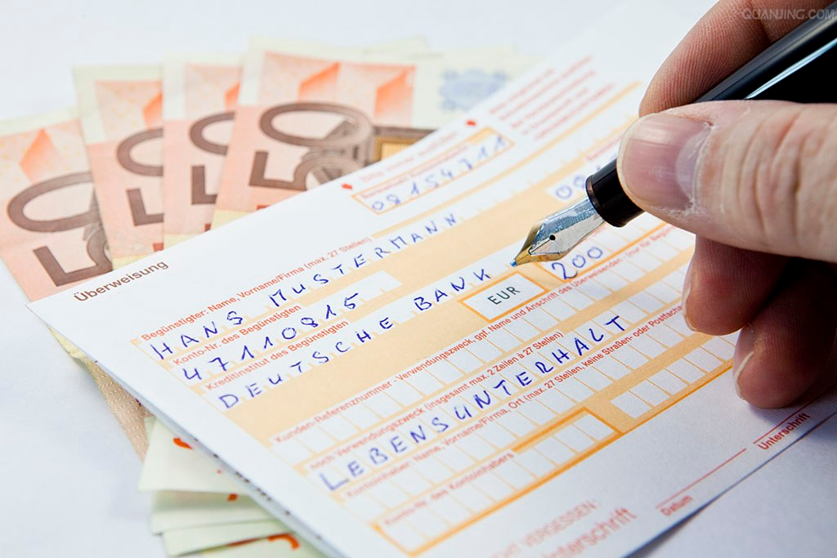
03
D/D
Demand Draft

Slide 9
D/D
Drawee
Importer
Exporter
Present
Apply
Issue
Pay
Drawer
Importer's Bank
Exporter's Bank
Payee
Transfer

Slide 10
14.2 Collection

Slide 11

Collection
A bank accepts seller’s collection order and document(s), presents the document(s) to the buyer and collects funds for the seller.

Slide 12
Clean Collection
Draft
Documentary Collection
Shipping Documents
Draft

Slide 13
Documentary Collection is a means of ensuring that goods (title documents) are handed over to the buyer (by a bank) only when the amount shown on a bill of exchange is paid or when the customer accepts the bill as a contract to pay by a specific date.
URC 522
(Uniform Rules for Collection)

Slide 14
Documents
against
Payment
Document
againt
Acceptance
D/P
D/A
D/P at sight
D/P after sight
Types

Slide 15

Upon first presentation the Buyers shall pay against documentary draft drawn by the Sellers at sight. The shipping documents are to be delivered against payment only.
D/P Sight

Slide 16
Principal
S/C
Exporter
Importer
Shipping Line
Exporter's Bank
Importer's Bank

Slide 17
The Buyers shall duly accept the documentary draft drawn by the Sellers at ××days sight upon first presentation and make payment on its maturity. The shipping documents are to be delivered against payment only.
D/P after Sight

Slide 18
S/C
Exporter
Importer
Shipping Line
Exporter's Bank
Importer's Bank

Slide 19
The Buyers shall duly accept the documentary draft drawn by the Sellers upon presentation and make payment at ××days sight (or after date of B/L). The shipping documents are to be delivered against acceptance.
D/A

Slide 20
Payment by draft payable 120 days after cargo arrival, documents against acceptance.
D/A

Slide 21
S/C
Exporter
Importer
Shipping Line
Exporter's Bank
Importer's Bank

Slide 22
Our company made a selling offer to a foreign company and suggested payment be made by D/P at 30 days after sight. Several days later, the foreign company replied and asked for payment by D/A at 30 days after sight.
Q: Can we accept this counter-offer? Why?

Slide 23
 | D/A | D/P after sight
Money | Same Maturity Commerical Credit
Goods | at buyer's disposal | at seller's disposal

Slide 24
How to finance when payment is made by collection?

Slide 25
Trust Receipt (T/R)
As importers

Slide 26
Our company made a selling offer to a Japanese company and suggested payment be made by D/P sight. The Japanese company counter-offered, "Your offer is accepted if payment could be made by D/P after 90 days through Bank A."
Q: Can we accept this counter-offer? Why?

Slide 27
Collection Bill Purchased
As exporters

Slide 28
Thank You

